Slide 1
Parity doublet model for baryon octets based on the quark-line diagram
Bikai Gao, Toru Kojo, Masayasu Harada
Dept. of Phys., Nagoya University
Nov. 8-9/2023, ELPH

Slide 2
Contents
Introduction
Model construction
Case analysis
Results

Slide 3
Introduction
Nucleon
Three quarks
The remained 99% of the nucleon mass is from the strong interaction between quarks.
Since strong interaction is very large in the vacuum, non-perturbative effect is essential for the generation of mass.
u
>>
u
u
d
d
u
~1000 MeV
~10 MeV
Where is the origin of mass?

Slide 4
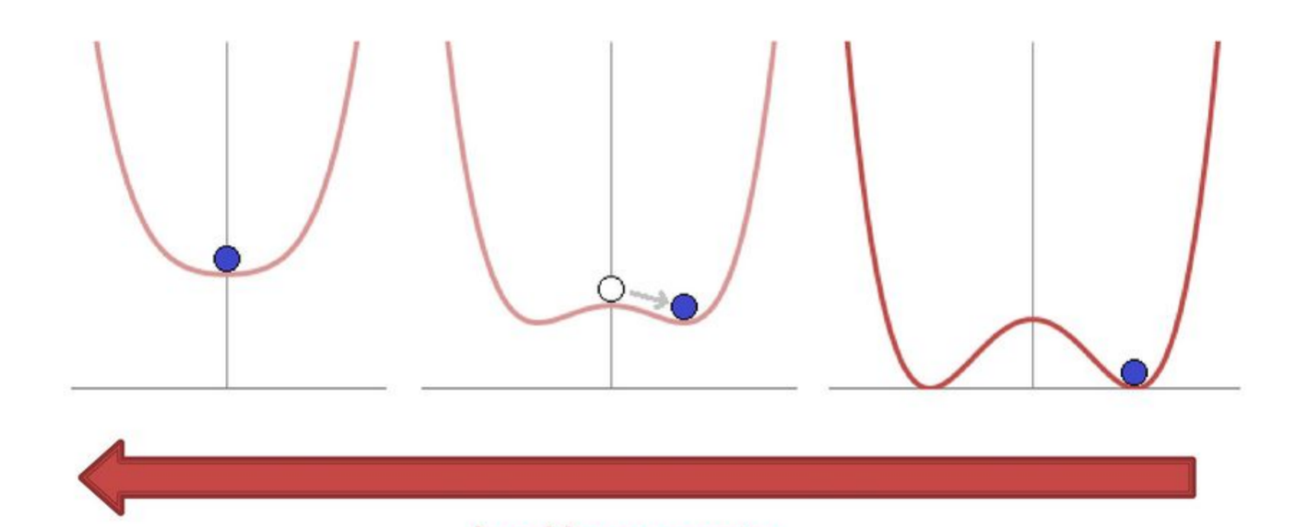
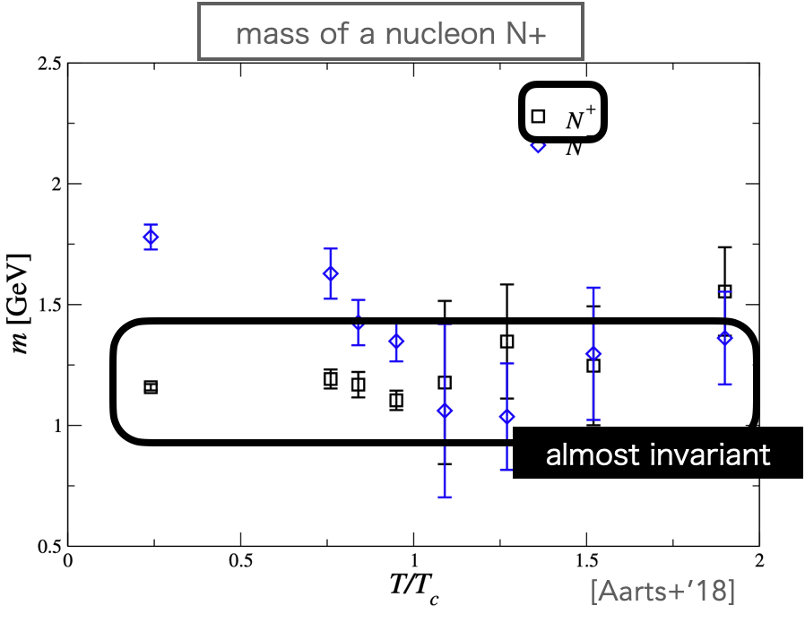
Introduction
order parameter
σ~
Contribution to mass from spontaneouly chiral symmetry breaking(SCSB)
Chiral symmetry broken phase
chiral symmetry restored phase
σ ≠ 0
σ = 0
density or temperature
2. Contribution to mass from chiral invariant mass m₀
Indicated by the lattice QCD and does not depend on SCSB.[PhysRevD.92.014503]

Slide 5
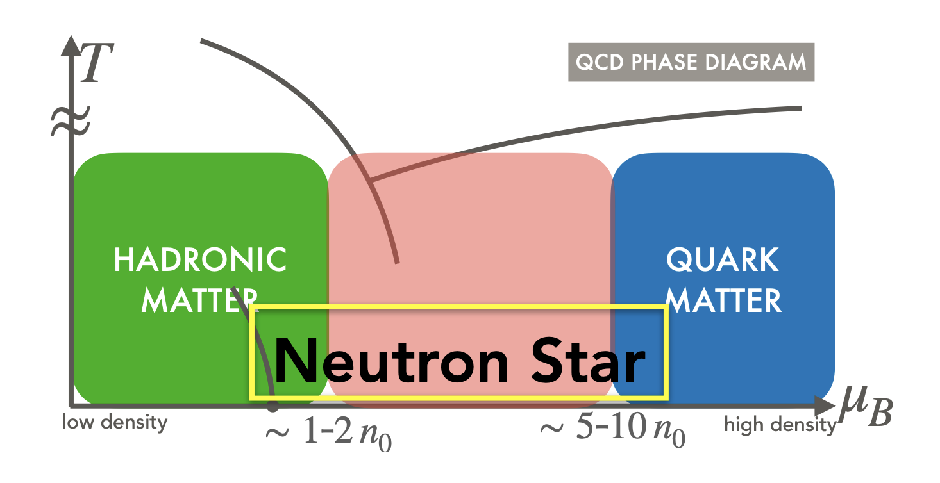
Introduction
Mass-radius relation
one-to-one correspondence
Neutron star equation of state
In NS, σ→0,
only chiral invariant mass remains.
Chiral invariant mass

Slide 6
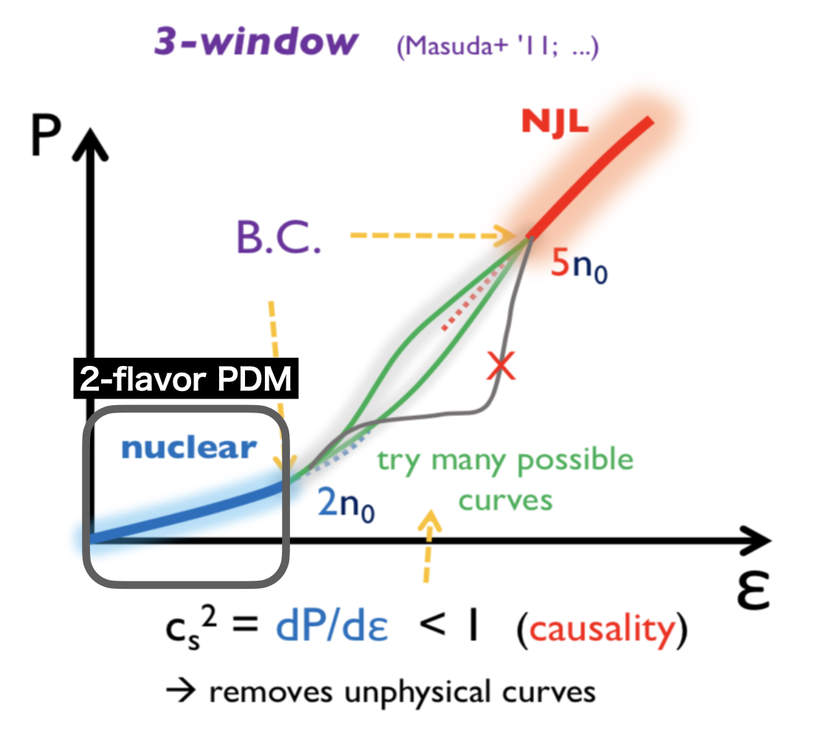
Introduction
T.Minamikawa, et al.(2021), PhysRevC.103.045205

Slide 7
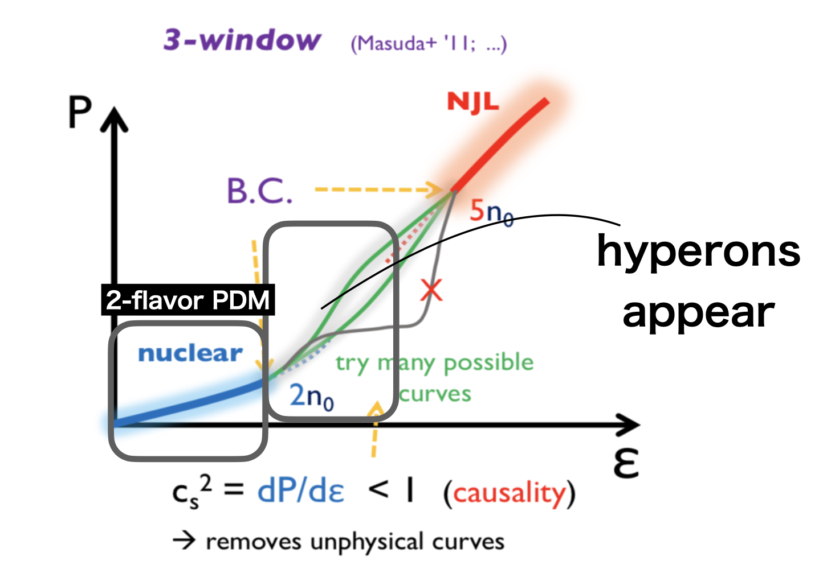
Introduction
MeV
7

Slide 8
Introduction
Motivation:
Need to construct chiral hadronic model(Parity doublet model) with hyperons
8

Slide 9
Contents
Introduction
Model construction
Case analysis
Results

Slide 10
Chiral Representation
Chiral representations of quarks under SU(3)_{L} X SU(3)_{R} are
Left-handed quark: q_{L} $\sim$ ( 3_{L} , 1_{R} ) Right-handed quark: q_{R} $\sim$ ( 1_{L} , 3_{R} )
We have the following possibilities for the chiral representations of baryons:
$B_{L}\sim q_{L} ⨂$ $q_{L}$ $⨂$ $q_{L }\sim \left(3, 1\right)⨂{ \left(3,1\right) ⨂{ }(3,1)}$
$\sim \left(1, 1\right)⨁2(8, 1)⨁(10, 1)$
$B_{L}\sim q_{L} ⨂$ $q_{R}$ $⨂$ $q_{R }\sim \left(3, 1\right)⨂{ \left(1,3\right) ⨂{ }(1,3)}$
$\sim \left(3, \overline{3}\right)⨁(3, 6)$

Slide 11
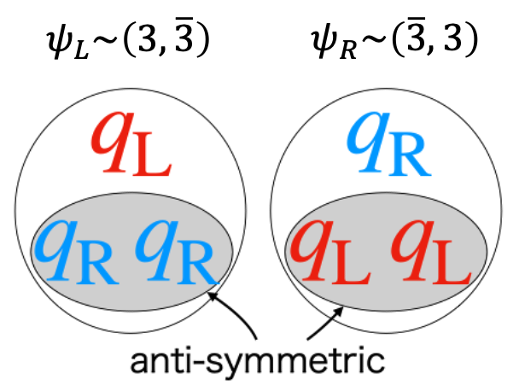
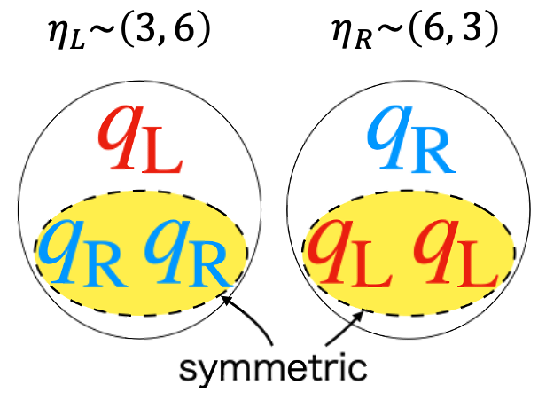
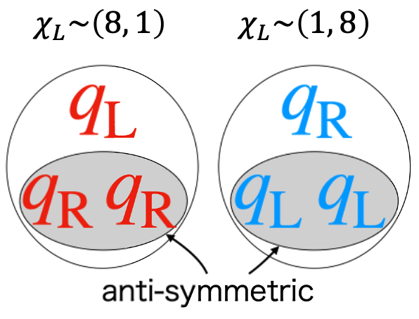
Chiral Representation
L
L
R
R

Slide 12
Contents
Introduction
Model construction
Case analysis
Results

Slide 13
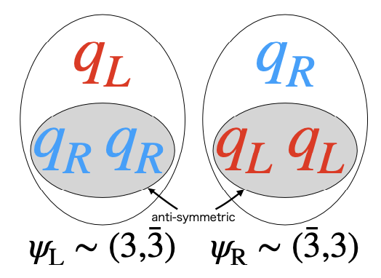
Model 1: only $ψ$
Only $ψ$ is included
$σ_{s}$ only contributes to the $Σ$ baryons
Problem: m[N] = m[$Ξ$] in this model

Slide 14
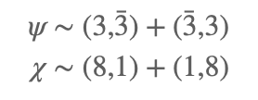
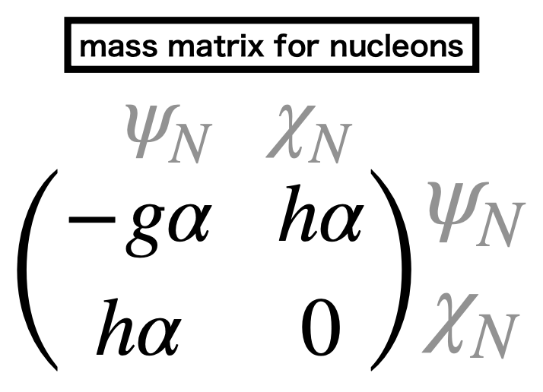
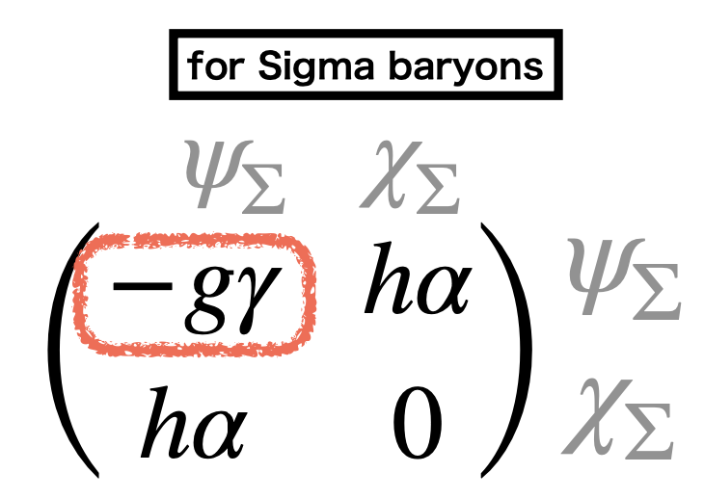
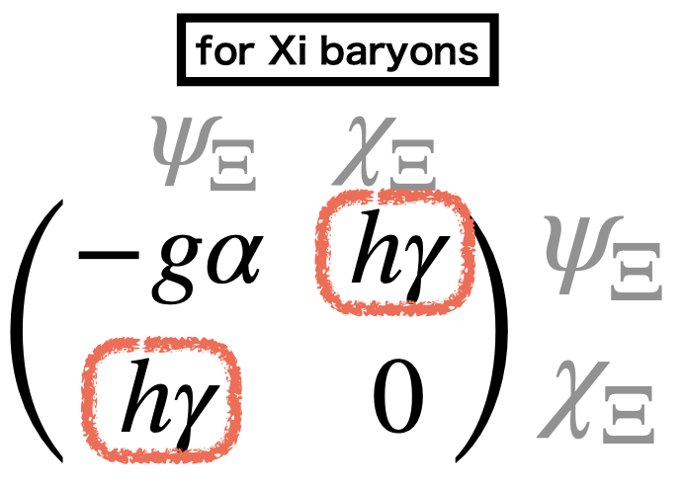
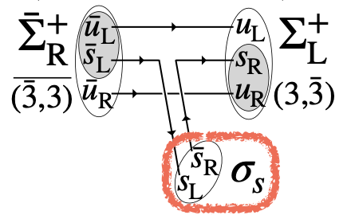
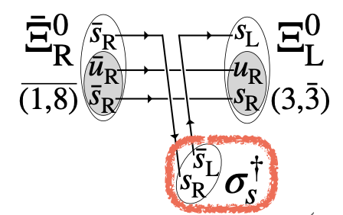
Model 2: $ψ$ and $χ$
$$\left(\begin{matrix}x & y \\ y & 0\end{matrix}\right)$$
$∂_{x}$m(x, y) < 0 therefore m[N] > m[$Σ$]

Slide 15
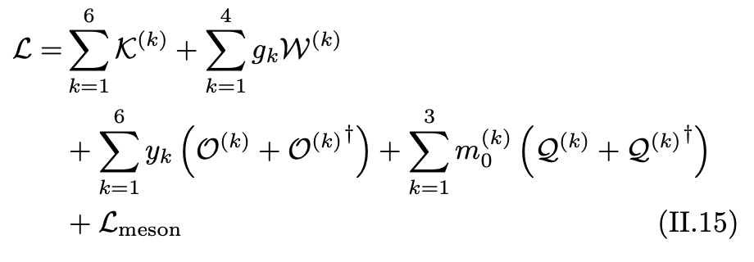
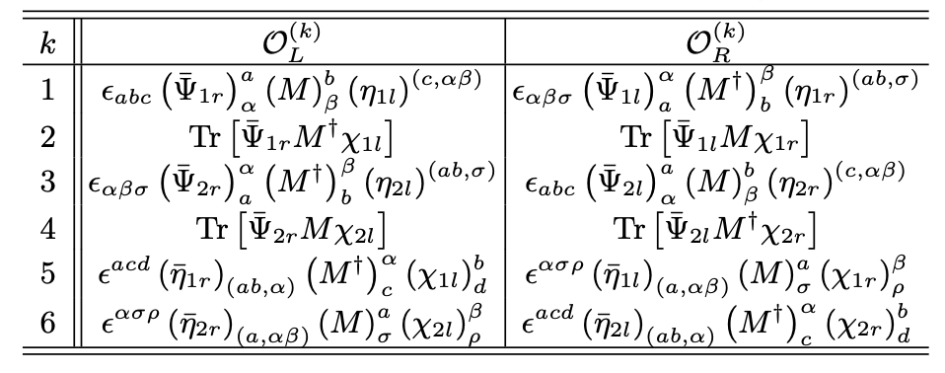
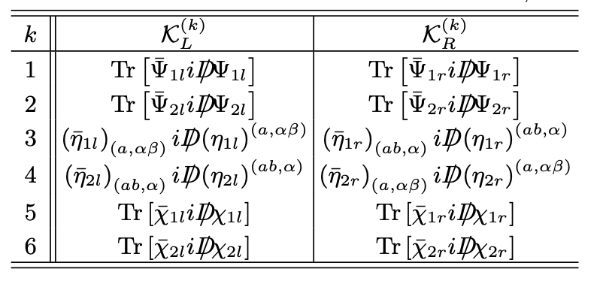
Model 3: $ψ$, $η$ and $χ$
$$ψ\sim \left(3, \overline{3}\right)+\left(\overline{3},3\right)$$
$$η\sim \left(3,6\right)+(6,3)$$
$$χ\sim \left(8,1\right)+(1,8)$$

Slide 16
Parameter fitting
Using the following 12 mass values
We fit the ten Yukawa coupling constants by minimizing the following function:
For ground-state baryons $δm_{i}$ = 10 MeV and for excited baryons we take $δm_{i}$ = 100 MeV
We also require
$\sum_{i}{\left|∆_{GO,i}\right|}$ < 100 MeV where $∆_{GO, i }=\frac{m_{i}\left[N\right] +m_{i}[Ξ]}{2} − \frac{3m_{i}\left[Λ\right] + m_{i}[Σ]}{4}$

Slide 17
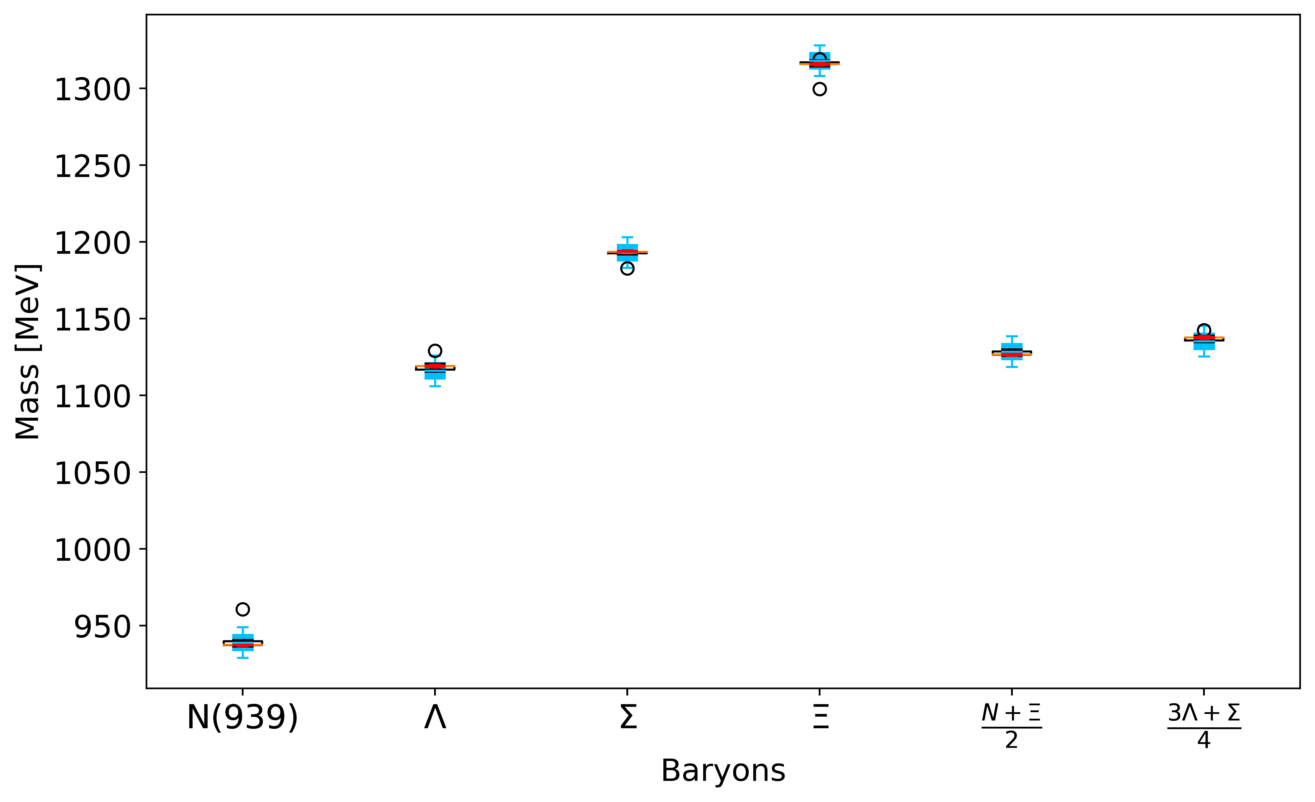
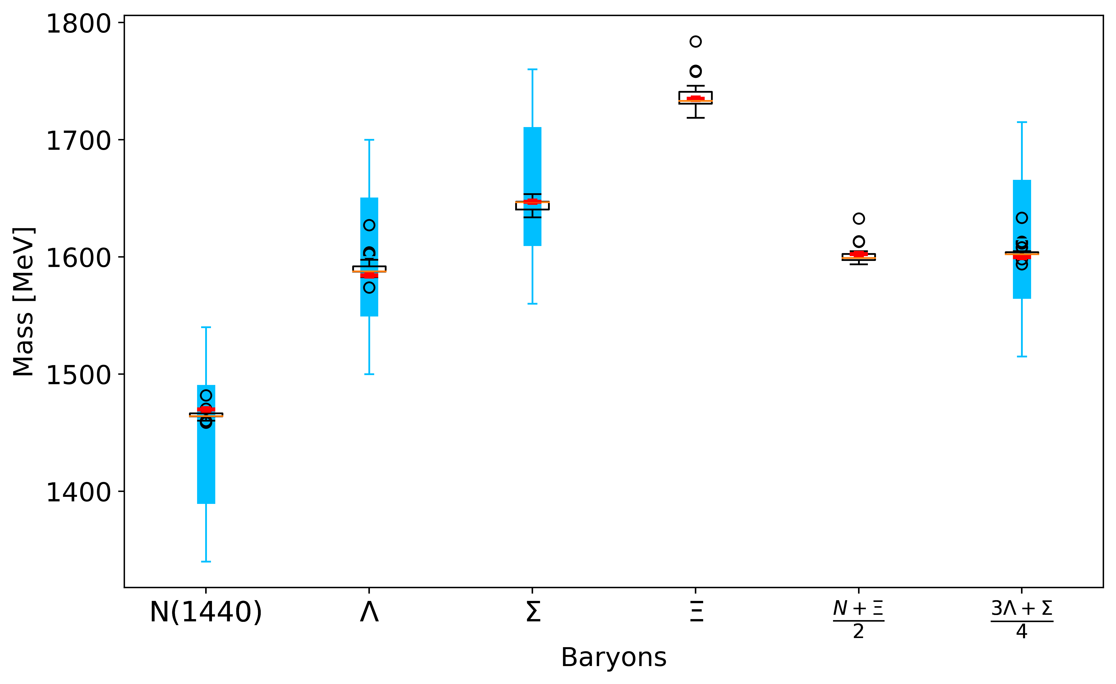
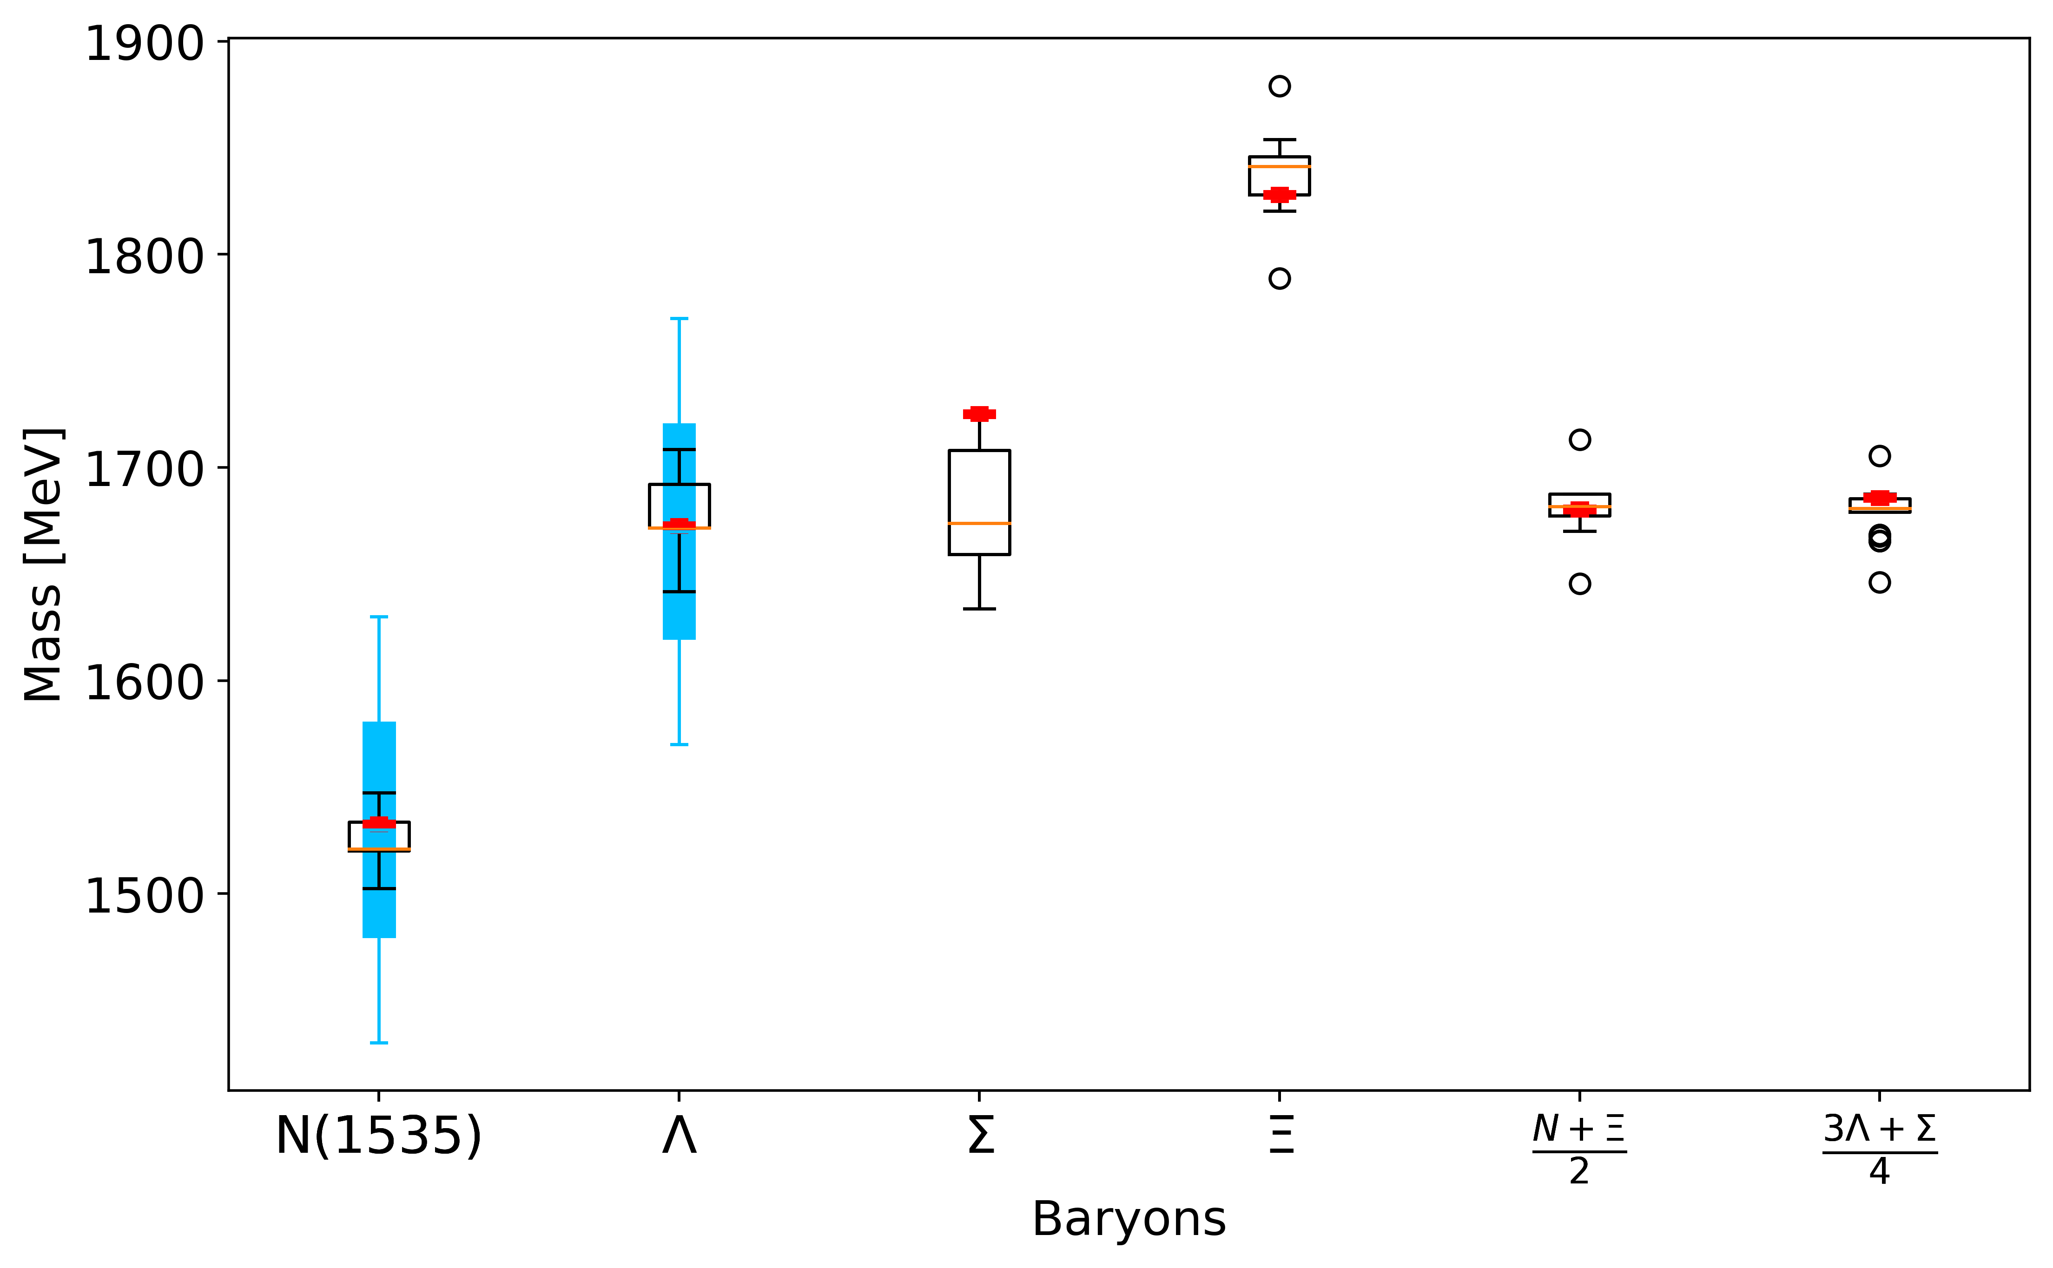
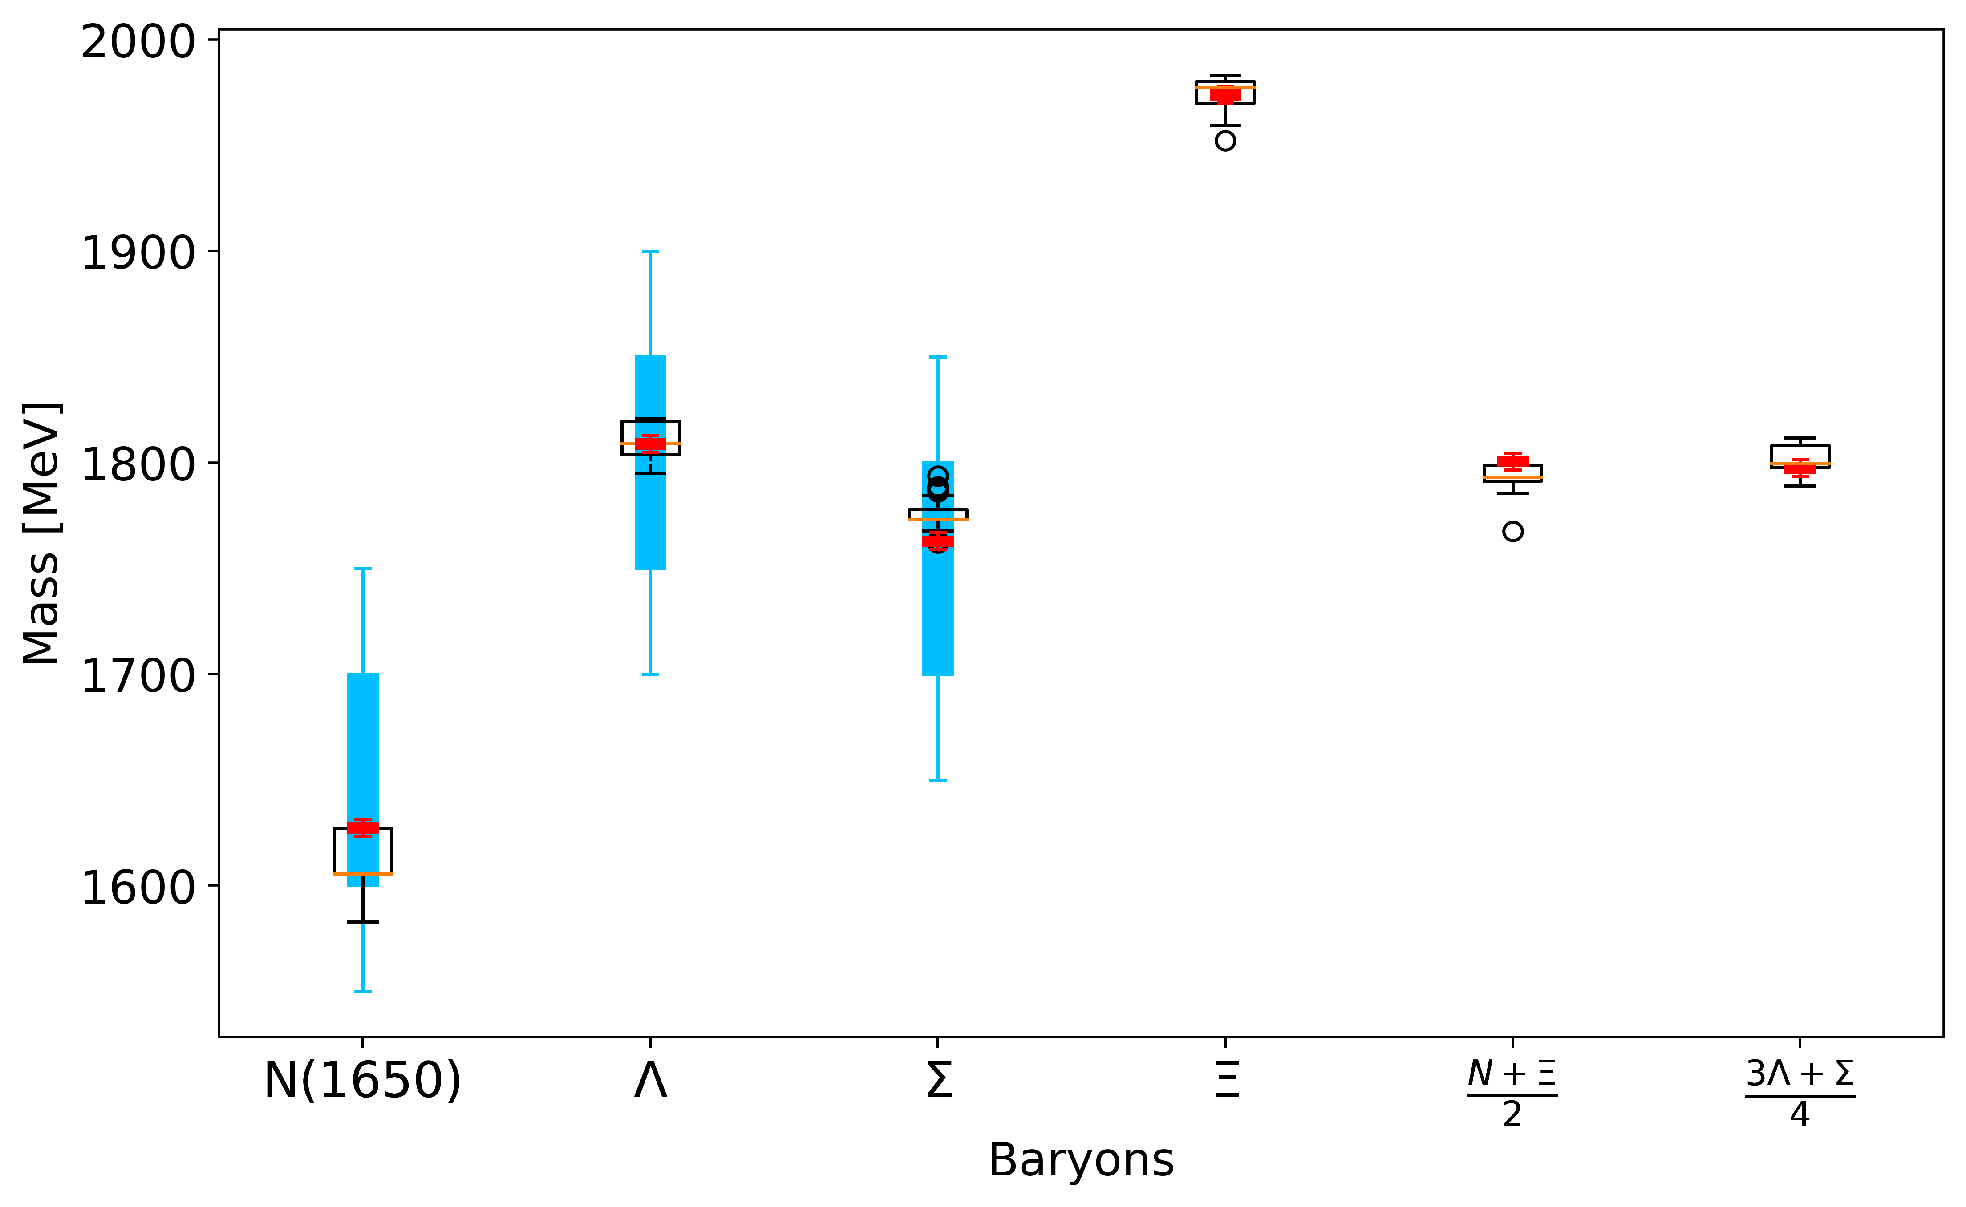
Results
$m_{ψ}=m_{χ}=700$ MeV
$m_{η}=1000$ MeV
Gell-Mann-Okubo
Mass formula
$$\frac{m\left[N\right] +m [Ξ]}{2}= \frac{3m\left[Λ\right] +m[Σ]}{4}$$

Slide 18
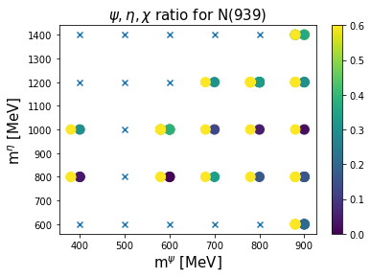
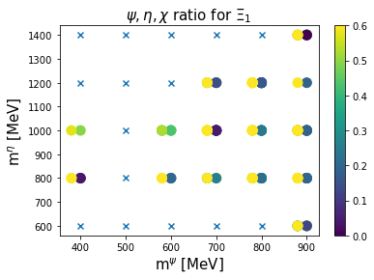
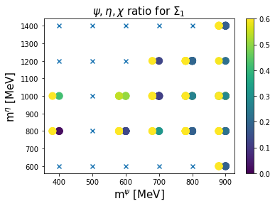
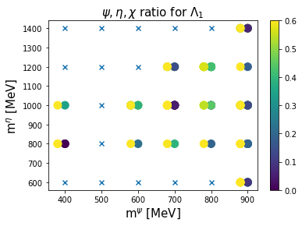
Results
For each cases, we find for ground state, mix ratio of (3, 6) + (6, 3) is relatively small

Slide 19
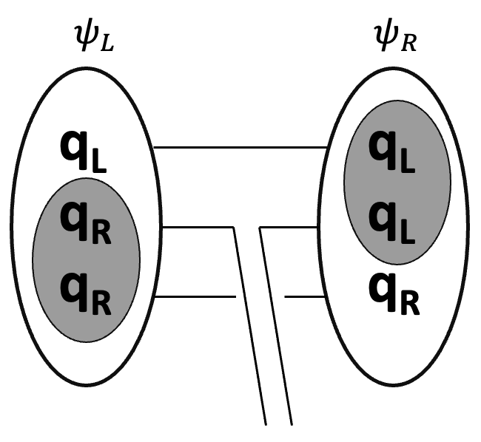
Summary & Future work
We successfully constructed a chiral model in SU(3) case.
(No such kind of chiral model before)
Yukawa interactions are constrained by the quark dynamics
Hyperon mass spectrum are well reproduced
We find (3, 6)+(6, 3) representation is not dominant in the ground state
In the future, using our new chiral model to study the neutron star properties and try to find some clues about the origin of mass

