Slide 1
Reproduction of Internal Proton pressure using MIT bag model
RCNP Theory Group (Osaka University) M2 Riku Kojima
Daisuke Fujii, Akihiro Iwanaka, and Atsushi Hosaka
11/8 ELPH研究会@

Slide 2
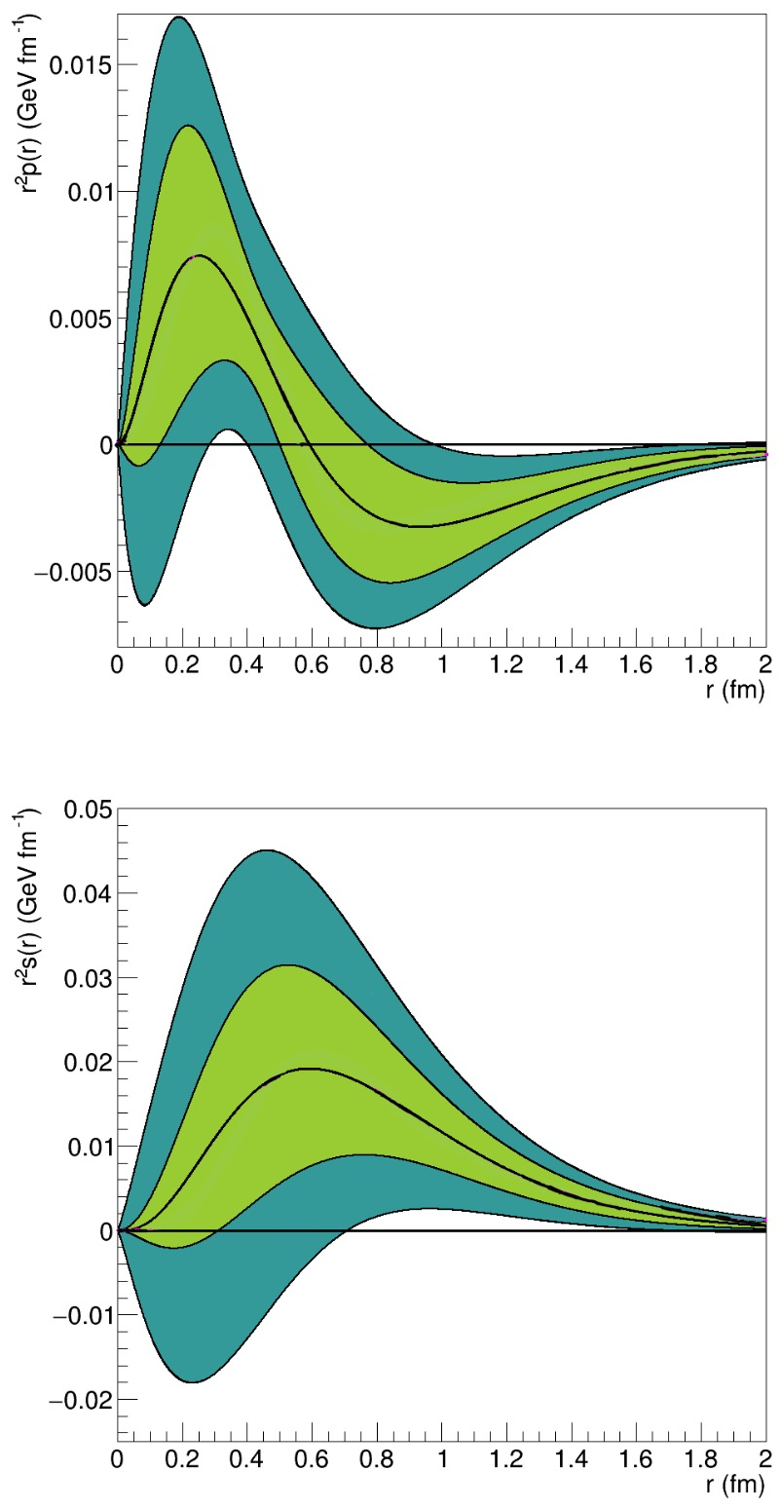
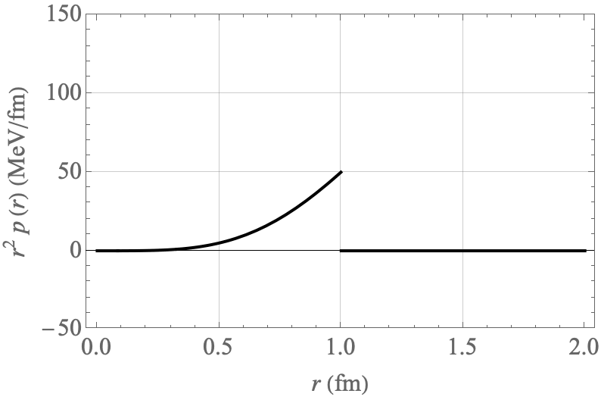
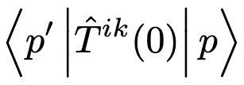

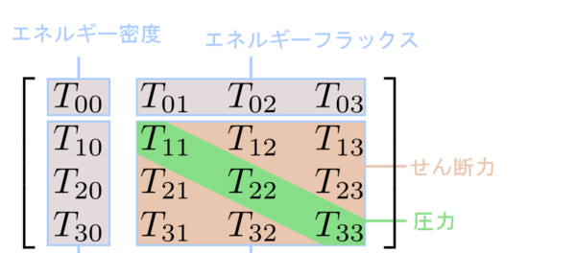

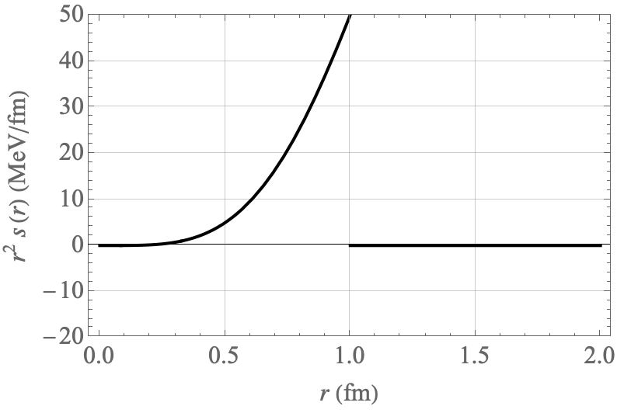
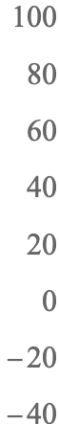
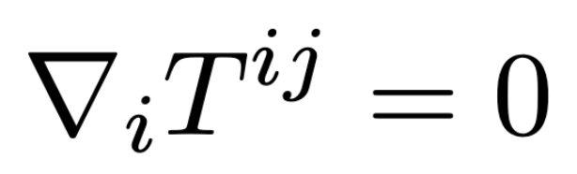
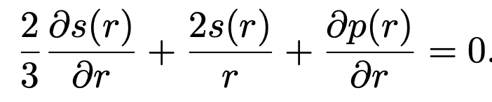
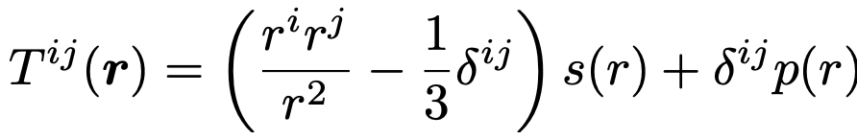
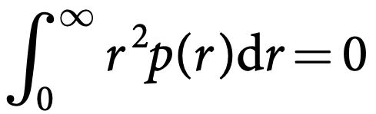
Why focus on pressure?
Burkert, Elouadrhiri, Girod,
Nature Vol.557, 396 (2018)
Non-perturbative
phenomena in QCD
EMT matrix element
Repulsive
Chiral symmetry breaking
Confinement
etc…
Gravitational
form factor
Stability by pressure distribution
Confining
Energy density
Current
Future
Shear stress
Pressure
Burkert, Elouadrhiri, Girod (2021)
2/8

Slide 3
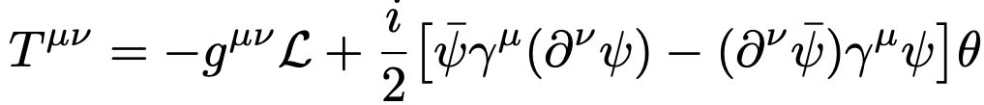
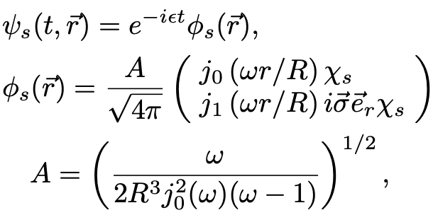
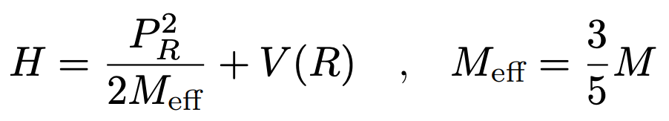
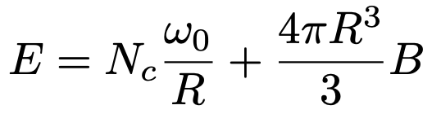
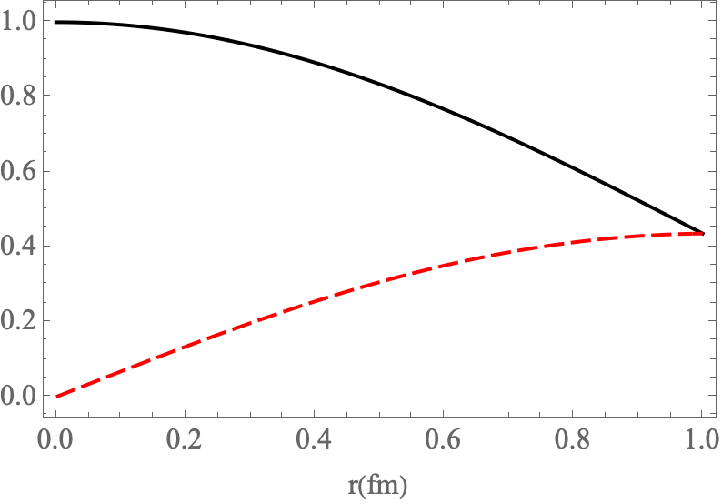
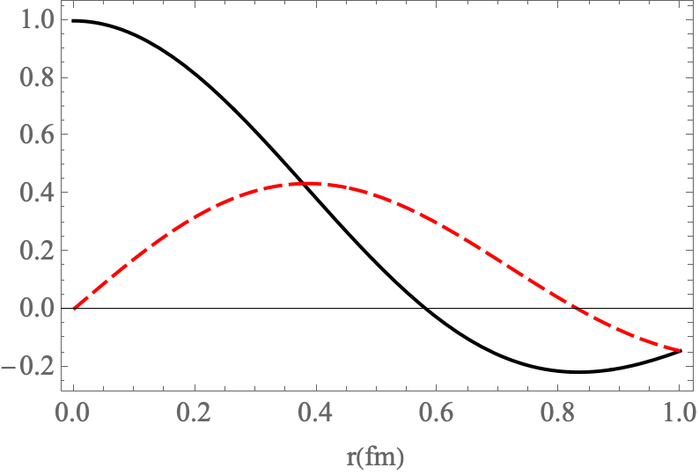





MIT bag model
A. Chodos, R. L. Jaffe, K. Johnson, C. B. Thorn, and V. F. Weisskopf, New extended model of hadrons, Phys. Rev. D 9, 3471 (1974).
perturbative
vacuum
Non-perturbative
vacuum
$$R$$
〜1fm
$B$: Bag pressure
$$B=97.5 MeV/fm^{3}$$
$\vec{σ}$ : Pauli matrix, $χ_{s}$ : 2-component spinor, $j_{n}(x)$ : Spherical Bessel function
$$ω_{0}=2.04$$
$$ω_{1}=5.40$$

Slide 4
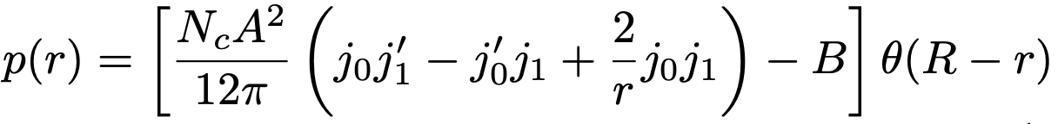
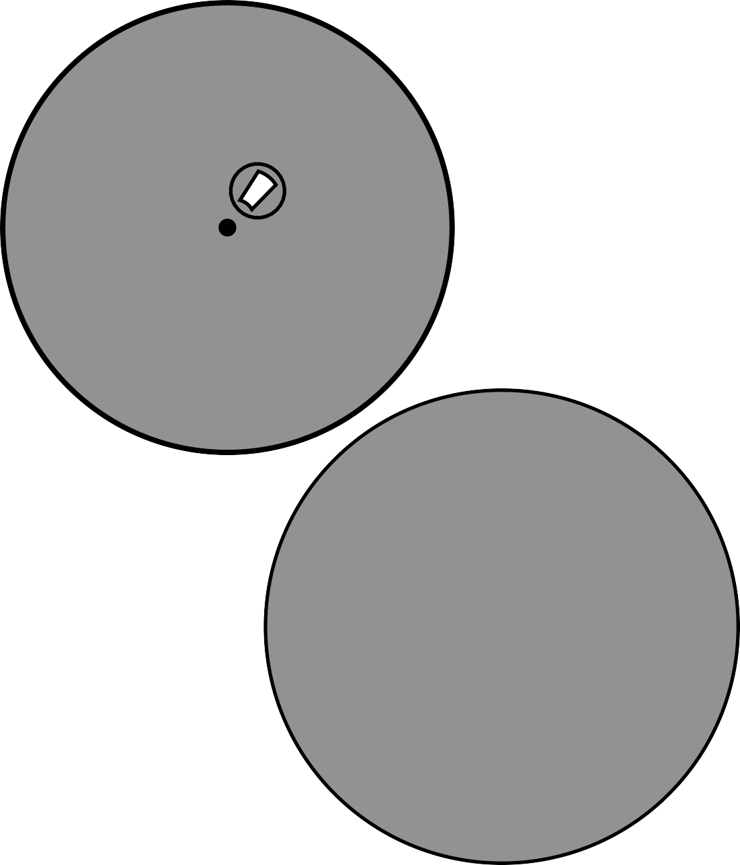
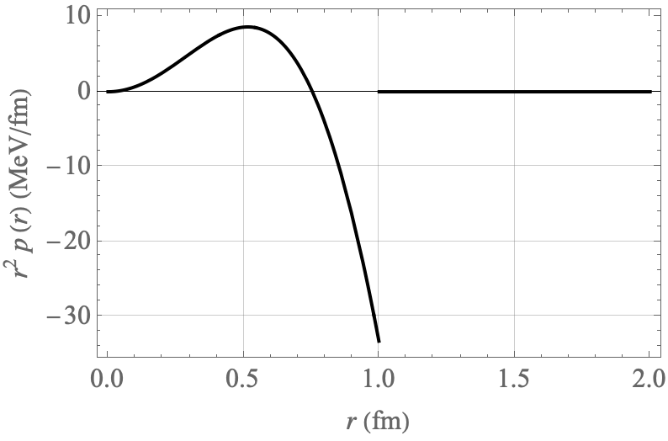
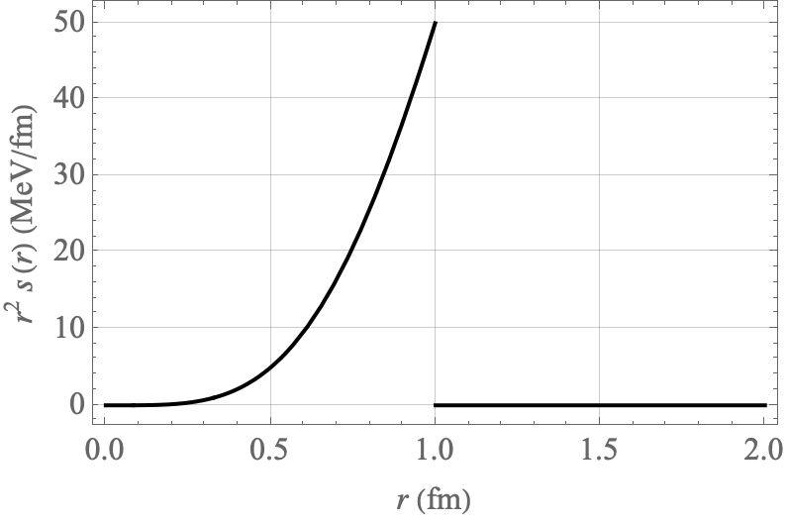


Pressure in MIT bag model
Neubelt, Sampino, Hudson, Tezgin, Schweitzer PHYSICAL REVIEW D 101, 034013 (2020)
$$p_{r}$$
$$p_{t}$$
Bag pressure acts
as confinement.
discontinuous
distribution

Slide 5
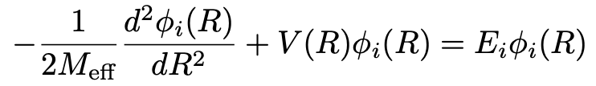
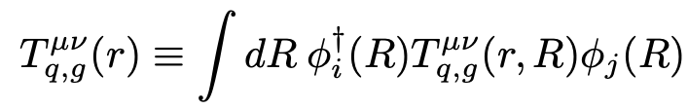


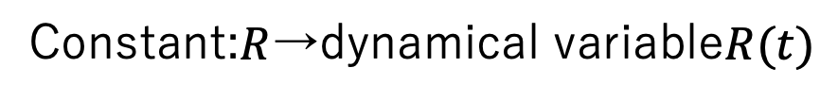

Oscillation of bag radius(Our Work)
G.E. BROWN, J.W. DURSO and MIKKEL B. JOHNSON Nuclear Physics A397 (1983) 447-468
Dissolution of discontinuity
Consider the bag as a classical elastic sphere.
(semiclassical approximation)
Constant:$R$→dynamical variable$R(t)$
collective
monopole
oscillation
$$R(t)$$
$P_{R}$: Canonical momentum of $R(t)$
$M:$ Nucleon mass
Superposition of probability distributions

Slide 6
Calculation Results
This work
LQCD
Adiabatic Approximation
Low on the inside.
/
The effects of pion
are not included.
Dissolution of discontinuity
Tail is not extended.
Collective Excited States
Roper resonance

Slide 7
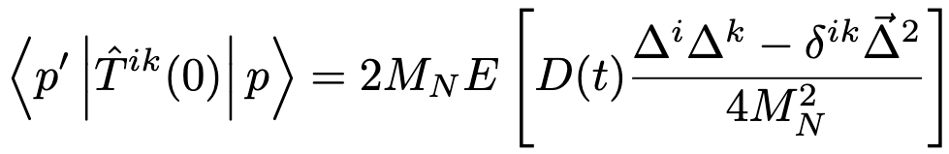


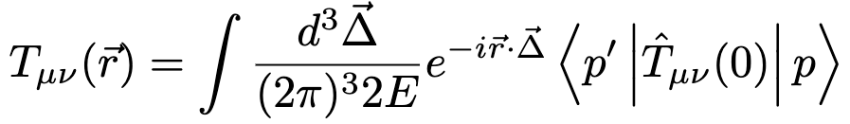
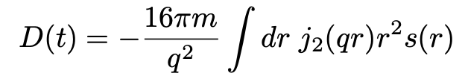



D-term in this work
free fermion
free boson
$$D=0$$
$$D=−1$$
D-term: $D=D(0)$

Slide 8
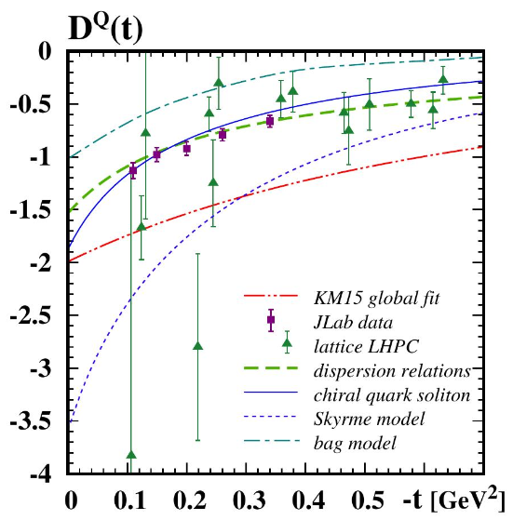
Summary and outlooks
The discontinuity was resolved by incorporating collective motion of the bag radius into the MIT bag model by considering zero-point oscillations.
The Roper resonance, a collective excitation for nucleons, was reproduced.
Compared to lattice QCD, the shear stress distribution was closer to that of the experiment. As for D-team, the obtained D=-1.17 is close to the experimental D=-1.63. (In LQCD, the average value is about -4)
Could we incorporate the contribution to the internal quark given by the bag to produce a pressure closer to the experiment? What would be the von Laue condition then?

Slide 10
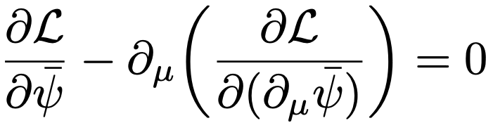

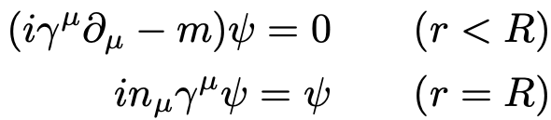
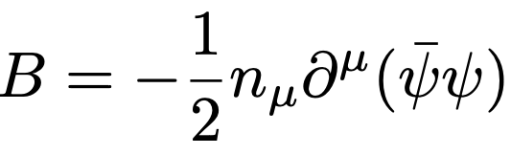
Lagrangian of MIT-Bag model
: Space vector perpendicular to the bag surface

Slide 11

Meaning of Boundary Conditions
No current passing through the bag boundary.
Bag pressure was introduced to satisfy energy-momentum conservation.
It is the external pressure, which is balanced by the internal quark pressure.
In other words, Bag pressure is an essential term to describe a stable nucleon.

Slide 12
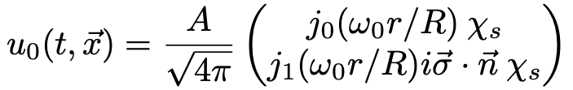
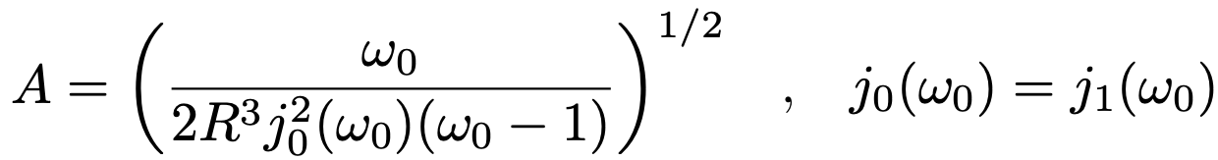
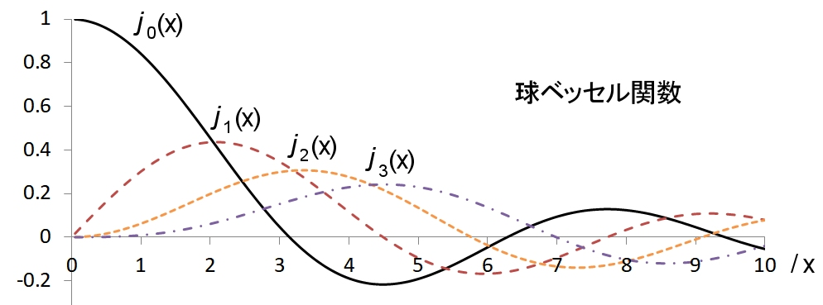



Wave function of the MIT-Bag model
The free Dirac equation is solved based on the boundary conditions; the radial direction is represented by a spherical Bessel function, as is the solution of the Schrodinger equation for a 3-dimensional well-shaped potential.
$\vec{σ}$ : Pauli matrix, $χ_{s}$ : 2-component spinor, $j_{n}(x)$ : Spherical Bessel function
Use boundary conditions to find $ω_{0}$.
$$ω_{0}=2.04$$

Slide 13
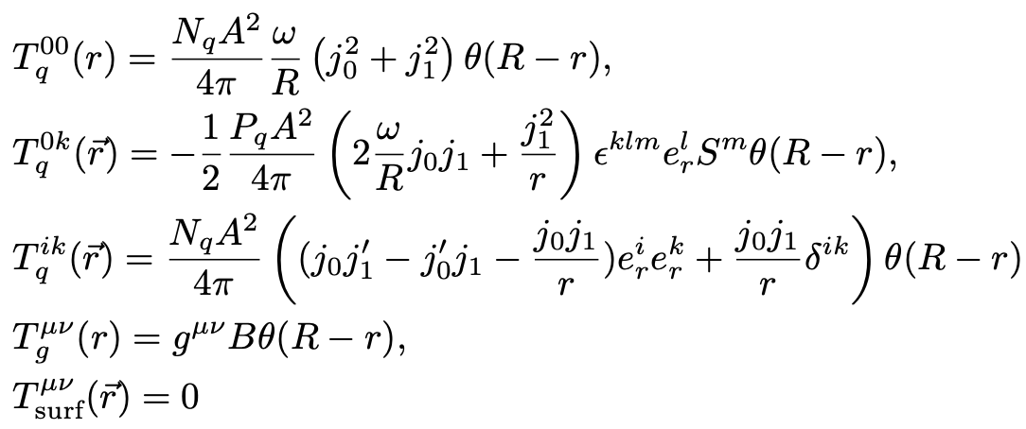
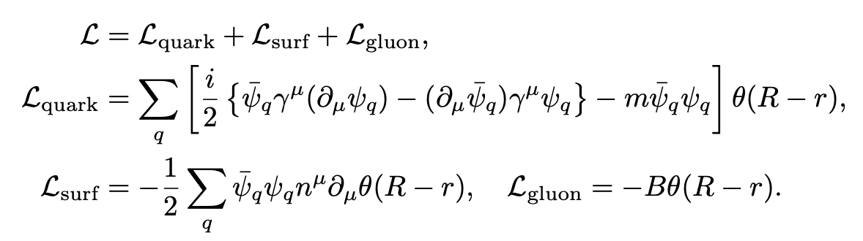
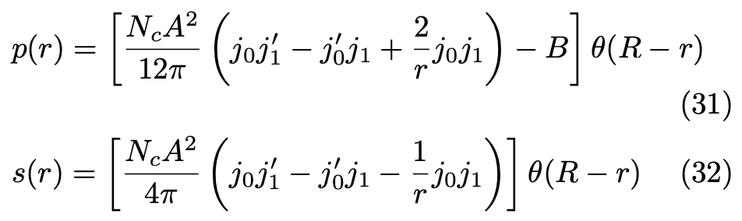
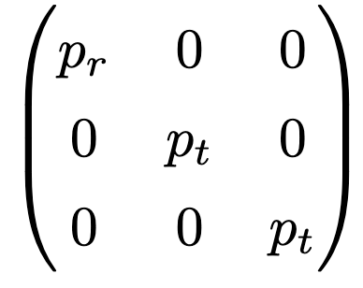
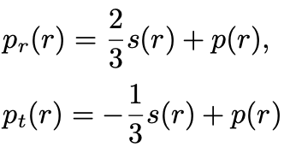
Pressure and shear stress in bag model
Shear stress
Pressure

Slide 14
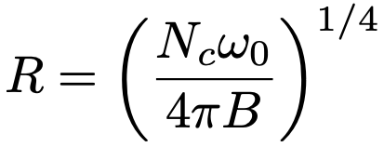

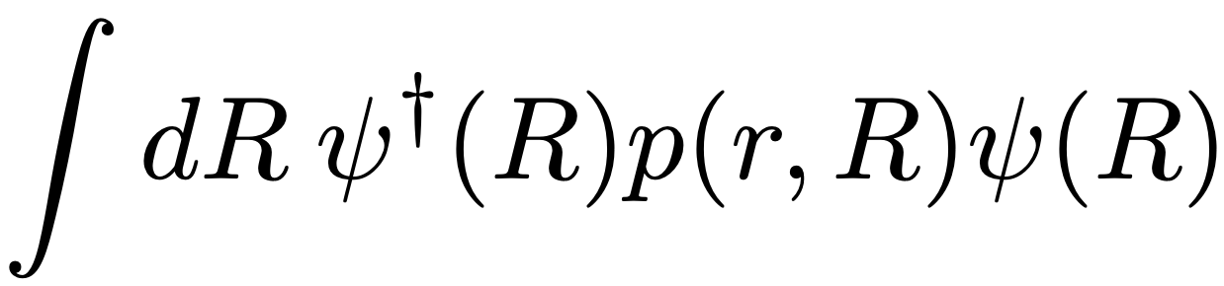
Elimination of discontinuities
The bag surface exists at a stable point where the internal quark pressure is balanced by the external bag pressure.
Consider that the bag surface itself is oscillating off the stability point.
The discontinuity at the bag surface is resolved by superimposing the pressure on the bag radius using the bag wave function for such a situation.
Note that this is different from the wave function at a fixed bag radius described earlier.

Slide 15
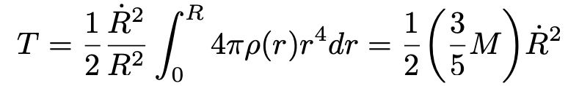
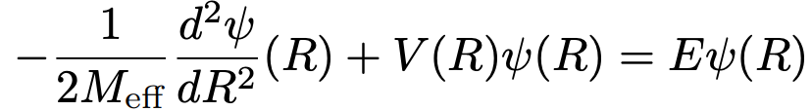
Bag radius fluctuation
G.E. BROWN, J.W. DURSO and MIKKEL B. JOHNSON Nuclear Physics A397 (1983) 447-468
Consider the bag as a classical elastic 球体(ball). (semiclassical approximation)

Slide 16
Pressure in MIT bag model
G.E. BROWN, J.W. DURSO and MIKKEL B. JOHNSON Nuclear Physics A397 (1983) 447-468

