Slide 1
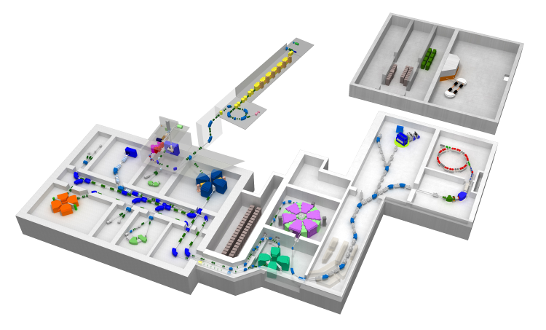
Present status and perspective of
the ISOL system, ERIS,
at the SCRIT electron scattering facility
LEES2024, October 28, 2024, Sendai
RIKEN Nishina Center
T. Ohnishi
and
SCRIT collaboration
ERIS: Electron beam-driven RI separator for SCRIT
RIKEN
RI Beam Factory
SCRIT Facility
Contents
Introduction
ERIS setup
Results
Future plan
SRC
BigRIPS
Notes:
Thank you for chairman, and thank you for organizers to give me a chance to introduce our ISOL facility, ERIS.
ERIS is electron beam-drived RI separator for SCRIT which is ISOL system at the SCRIT facility.
Contents of my talk is as follows.
I would like start with the introduction.

Slide 2
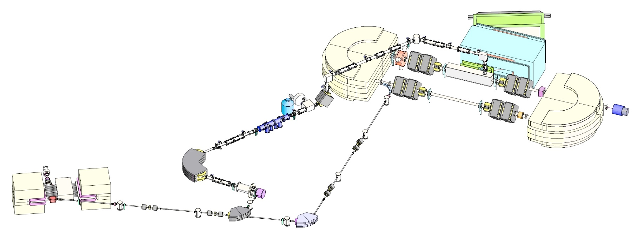
1. Introduction
SCRIT electron scattering facility
M. Wakasugi et al., NIMB 317 (2013) 668.
T. Ohnishi et al., NIMB 541 (2023) 380.
FRAC (Fringing RF field activated dc-to-pulse converter) cooler and buncher
SCRIT system
WiSES Magnetic spectrometer
LMon: Luminosity
monitor
ERIS
RI beam
SR2 (SCRIT equipped RIKEN Storage Ring)
100 ∼700 MeV, 200-300 mA
RTM (Race-track microtron)
150 MeV,0.5mA peak,2μs pulse
e-beam
Requirements for RI beams in SCRIT
Low-energy (～keV)
High quality (small emittance)
High intensity (～10⁸ ions/pulse)
ISOL system: ERIS
Notes:
This is the schematic layout of the SCRIT electron scattering facility.
Electron beam is accelerated by RTM to 150 MeV and it is injected to the electron storage ring SR2. After the accumulation, electron beam is transported to ERIS.
Produced RIs are extracted and transported to the SCRIT system installed inside the SR2.
In the transport line, FRAC, which is the cooler and buncher system, converts RI beam to pulsed beam.
For the SCRIT method, low-energy, high quality and high intensity are needed. To satisfy these requirements, we constructed the ISOL system, ERIS.

Slide 3
Character of ERIS
1. Photofission of uranium
Photofission (Ex ～ 15 MeV)
Thicker target can be applied.
2. Low-energy and high intensity RI beam separator
1 kW e-beam + U 30g → 10¹¹ fissions/sec (¹³²Sn 10⁹/sec)
First electron-beam ISOL facility in Japan
First full-scale ISOL facility in RIKEN
3. Sharing of electron beam driver
Shared use with the injection to storage ring ➔ Cost effective
4. Independent RI beam separator
Complementary to BigRIPS
Notes:
Character of ERIS are summarized as follows,
First, ERIS uses Photofission of uranium. Photofission can produce more neutron rich unstable nuclei than proton beam. (Slide change)
Thicker target can be applied.
Second, ERIS is low-energy and high intensity RI beam separator.
With 1kW electron beam and 30g uranium, 10^11 fissions/sec are available, and the rate of 132Sn is around 10^9 /sec.
In addition, ERIS is first electron beam ISOL facility in Japan, and it is also first full-scale ISOL facility at RIKEN.
Third, the e-beam driver is also used for the injection to storage ring. It is cost effective.
Last, ERIS is independent RI beam separator which is complementary to BIgRIPS.

Slide 4
Character of ERIS
1. Photofission of uranium
Photofission (Ex ～ 15 MeV)
Thicker target can be applied.
2. Low-energy and high intensity RI beam separator
1 kW e-beam + U 30g → 10¹¹ fissions/sec (¹³²Sn 10⁹/sec)
First electron-beam ISOL facility in Japan
First full-scale ISOL facility in RIKEN
3. Sharing of electron beam driver
Shared use with the injection to storage ring ➔ Cost effective
4. Independent RI beam separator
Complementary to BigRIPS
Notes:
Character of ERIS are summarized as follows,
First, ERIS uses Photofission of uranium. Photofission can produce more neutron rich unstable nuclei than proton beam. (Slide change)
Thicker target can be applied.
Second, ERIS is low-energy and high intensity RI beam separator.
With 1kW electron beam and 30g uranium, 10^11 fissions/sec are available, and the rate of 132Sn is around 10^9 /sec.
In addition, ERIS is first electron beam ISOL facility in Japan, and it is also first full-scale ISOL facility at RIKEN.
Third, the e-beam driver is also used for the injection to storage ring. It is cost effective.
Last, ERIS is independent RI beam separator which is complementary to BIgRIPS.

Slide 5
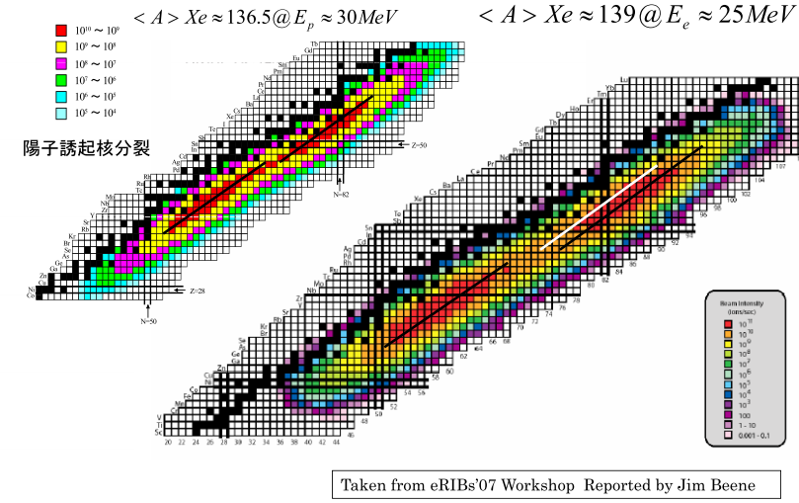
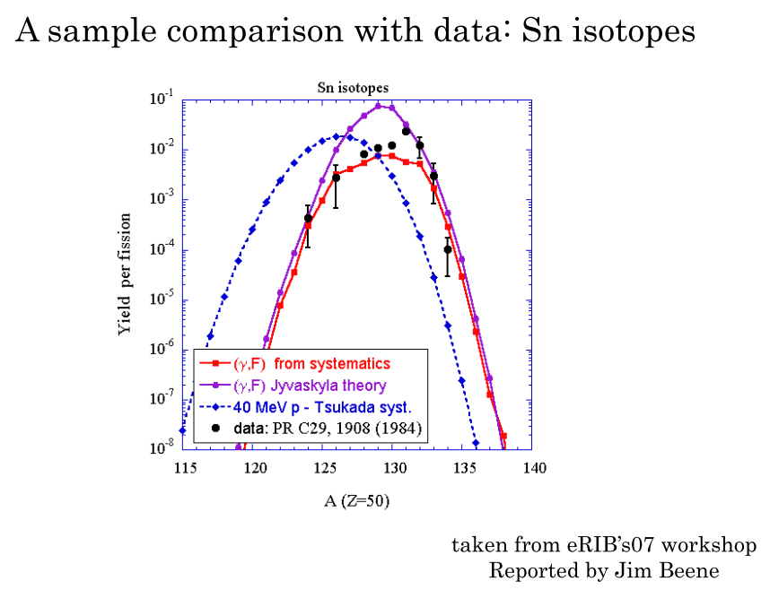
Photo fission vs Proton induced fission
Proton induced
Photo fission
Photofission has advantage to produce more neutron rich (2～3 neutron) unstable nuclei.
Notes:
This slide shows the comparison between photo fission and proton induced fission.
In the left figure, left and right nuclear charts show the distribution of produced RI in the proton induced fission and photofission, respectively.
In the right nuclei chart, white line shows the peak position in the proton induced fission. Compared with this line, the peak position in photofission locates more neutron rich side, around more 2 or 3 neutron.
Right figure shows more detail. This is the isotope dependence of the production rate of Sn isotopes. Red and blue lines show rates in the photofission and proton induced fission, respectively.
From these results, photofission has advantage to produce more neutron rich unstable nuclei.

Slide 6
Character of ERIS
1. Photofission of uranium
Photofission (Ex ～ 15 MeV) ➔
More neutron rich unstable nuclei than proton beam
Thicker target can be applied.
2. Low-energy and high intensity RI beam separator
1 kW e-beam + U 30g → 10¹¹ fissions/sec (¹³²Sn 10⁹/sec)
First electron-beam ISOL facility in Japan
First full-scale ISOL facility in RIKEN
3. Sharing of electron beam driver
Shared use with the injection to storage ring ➔ Cost effective
4. Independent RI beam separator
Complementary to BigRIPS
Notes:
Character of ERIS are summarized as follows,
First, ERIS uses Photofission of uranium. Photofission can produce more neutron rich unstable nuclei than proton beam. (Slide change)
Thicker target can be applied.
Second, ERIS is low-energy and high intensity RI beam separator.
With 1kW electron beam and 30g uranium, 10^11 fissions/sec are available, and the rate of 132Sn is around 10^9 /sec.
In addition, ERIS is first electron beam ISOL facility in Japan, and it is also first full-scale ISOL facility at RIKEN.
Third, the e-beam driver is also used for the injection to storage ring. It is cost effective.
Last, ERIS is independent RI beam separator which is complementary to BIgRIPS.

Slide 7
Character of ERIS
1. Photofission of uranium
Photofission (Ex ～ 15 MeV) ➔
More neutron rich unstable nuclei than proton beam
Thicker target can be applied.
2. Low-energy and high intensity RI beam separator
1 kW e-beam + U 30g → 10¹¹ fissions/sec (¹³²Sn 10⁹/sec)
First electron-beam ISOL facility in Japan
First full-scale ISOL facility in RIKEN
3. Sharing of electron beam driver
Shared use with the injection to storage ring ➔ Cost effective
4. Independent RI beam separator
Complementary to BigRIPS
Notes:
Character of ERIS are summarized as follows,
First, ERIS uses Photofission of uranium. Photofission can produce more neutron rich unstable nuclei than proton beam. (Slide change)
Thicker target can be applied.
Second, ERIS is low-energy and high intensity RI beam separator.
With 1kW electron beam and 30g uranium, 10^11 fissions/sec are available, and the rate of 132Sn is around 10^9 /sec.
In addition, ERIS is first electron beam ISOL facility in Japan, and it is also first full-scale ISOL facility at RIKEN.
Third, the e-beam driver is also used for the injection to storage ring. It is cost effective.
Last, ERIS is independent RI beam separator which is complementary to BIgRIPS.

Slide 8
Character of ERIS
1. Photofission of uranium
Photofission (Ex ～ 15 MeV) ➔
More neutron rich unstable nuclei than proton beam
Thicker target can be applied.
2. Low-energy and high intensity RI beam separator
1 kW e-beam + U 30g → 10¹¹ fissions/sec (¹³²Sn 10⁹/sec)
First electron-beam ISOL facility in Japan
First full-scale ISOL facility in RIKEN
3. Sharing of electron beam driver
Shared use with the injection to storage ring ➔ Cost effective
4. Independent RI beam separator
Complementary to BigRIPS
Notes:
Character of ERIS are summarized as follows,
First, ERIS uses Photofission of uranium. Photofission can produce more neutron rich unstable nuclei than proton beam. (Slide change)
Thicker target can be applied.
Second, ERIS is low-energy and high intensity RI beam separator.
With 1kW electron beam and 30g uranium, 10^11 fissions/sec are available, and the rate of 132Sn is around 10^9 /sec.
In addition, ERIS is first electron beam ISOL facility in Japan, and it is also first full-scale ISOL facility at RIKEN.
Third, the e-beam driver is also used for the injection to storage ring. It is cost effective.
Last, ERIS is independent RI beam separator which is complementary to BIgRIPS.

Slide 9
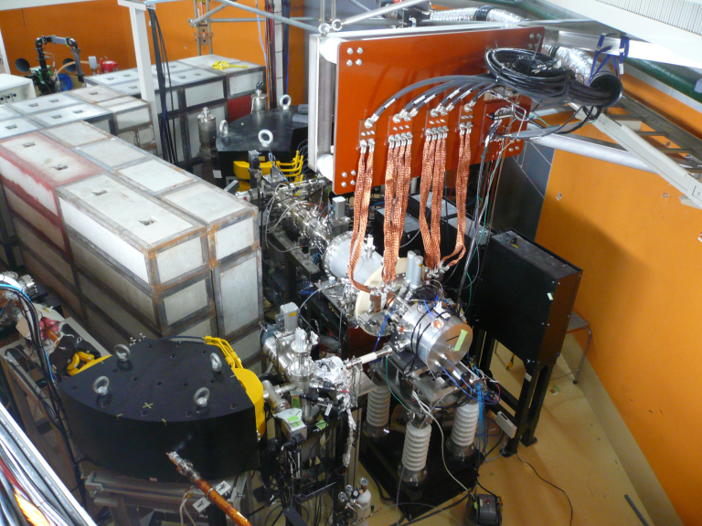
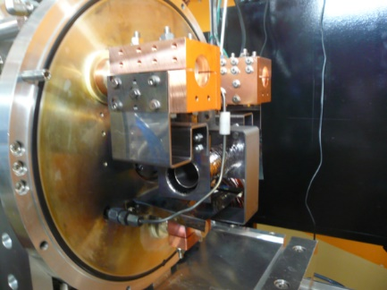
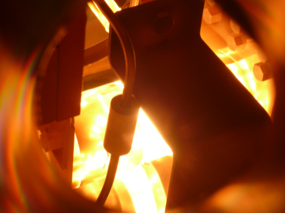
2. ERIS setup
Production target + Ion source + Transport line
RI beam
Target&Heater
Target&
Ion Source
e-beam
2000℃
2009 Construction start
Commissioning & Uranium target production
2013 First RI beam produced by uranium photo-fission
2016 Grid operation for pre-stacking
2017 Surface ionization type ion source
2022 e-RI scattering experiment using online-produced RI
Notes:
Next, I would like show ERIS setup.
ERIS consist of production target, ion source, and transport line.
This photograph shows ERIS. Target and ion source are located here.
This photograph shows target and heater inside the chamber, and this shows the target heated to 2000 degree.
Electron beam comes from this side and irradiates the target.
Produced RIs are extracted and RI beams are transported to the SCRIT system.
A brief history is summarized here.
At 2009, the construction was started, and first RI beam was produced by uranium photofission at 2013.
After the development, electron scattering with online-produced RI was performed at 2022.
Next, I would like to talk about each component of ERIS.

Slide 10
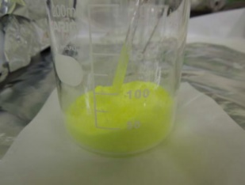
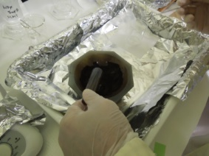
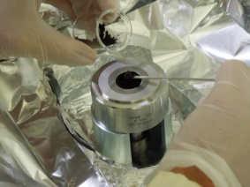
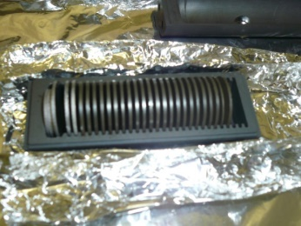
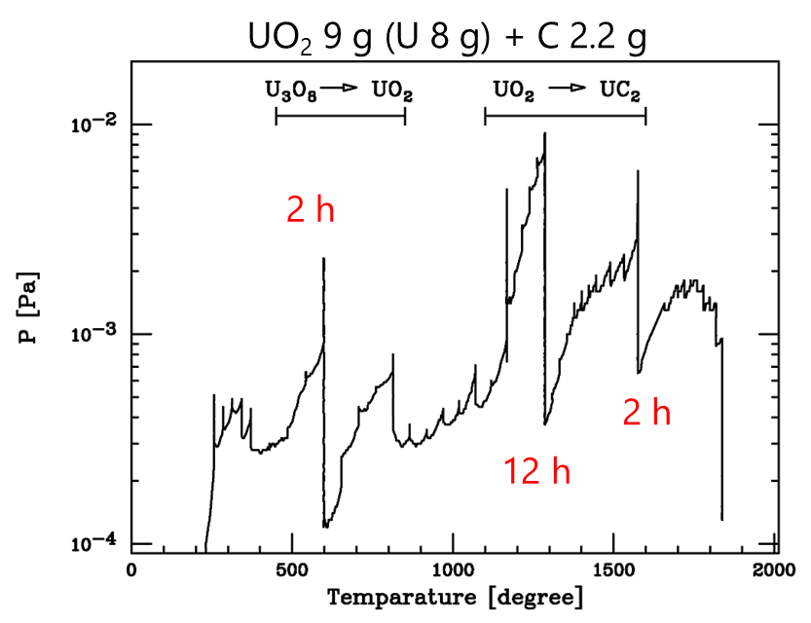
Production target
Self-made Uranium carbide disk
Uranyl nitrate solution mixed with graphite powder (20μm)
Oxidization around 500 °C
180 MPa compression with no binder
Φ 20 mm, t = 1 mm
Uranium-oxide disk
Carbothermal reduction
U₃O₈ +C ➔ 3UO₂+CO₂ at 600-800℃
UO₂ + 4C ➔ UC₂ + 2CO at 1100-1600℃
Ref. Gmelin handbook Supp. Vol. C12
Uranium carbide disk
Uranium carbide disk
Φ 18 mm, t 0.8 mm
43 disks U-28 g
→ U density 3.2 g/cm3)
Left side: Ta converter
Right side: C spacer
Notes:
Concerning production target, self-made uranium carbide target is used.
Using uranyl nitrate solution with graphite powder, an uranium-oxide disk is made by 180MPa compression with no binder. The diameter and thickness of a disk are 20 mm and 1 mm , respectively.
This photograph shows uranyl nitrate solution, and these photo show the making procedure.
As next step. the carbothermal reduction is applied to convert from uranium oxide disk to uranium carbide disk.
This figure shows sample result of the trend of the pressure depend on the temperature.
According to these chemical reactions, several peak of the pressure are observed.
After several days, finally, uranium carbide disk is made. The diameter and thickness of obtained carbide disk are reduced as 18 mm and 0.8 mm, respectively. The density of uranium is around 3.2 g/cm3.

Slide 11
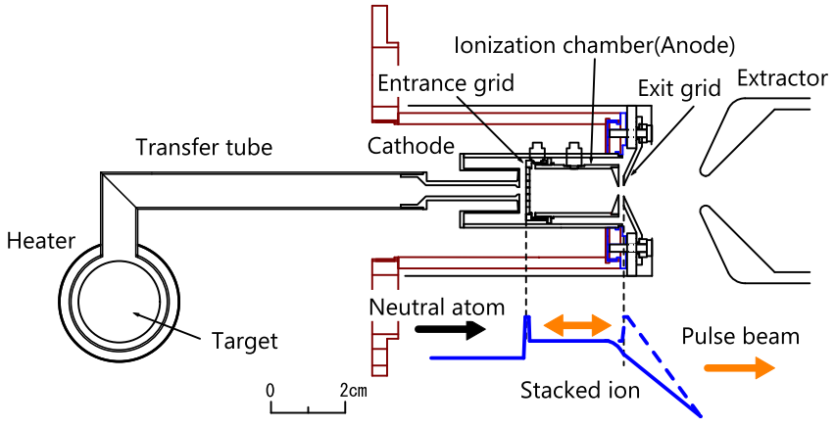
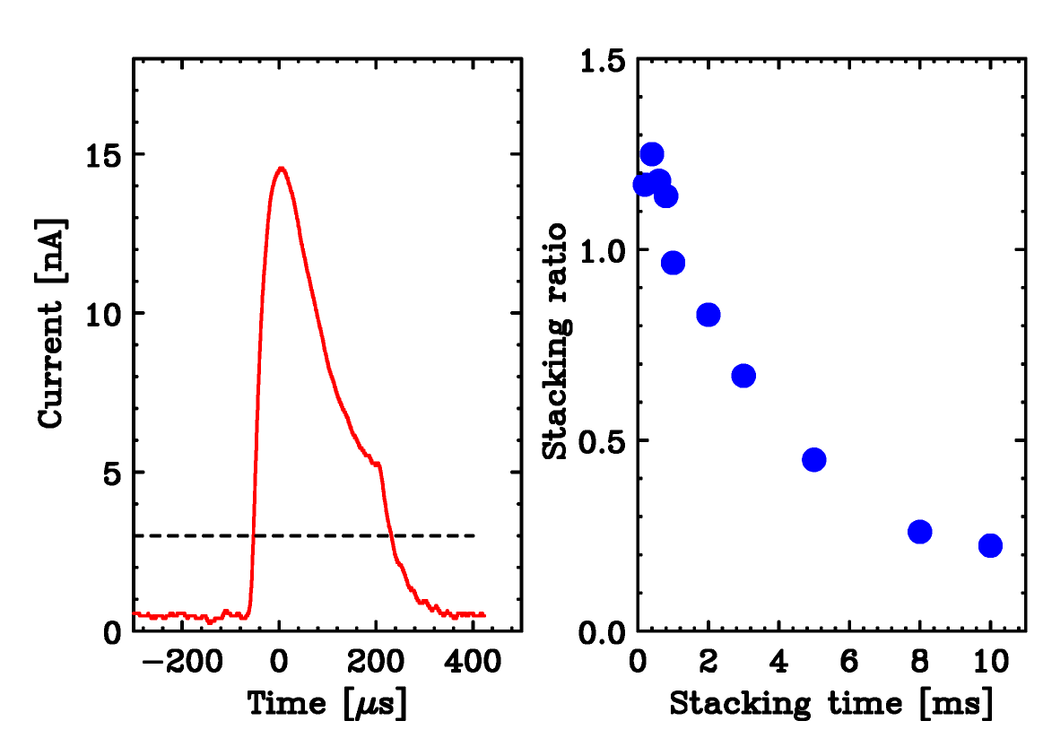
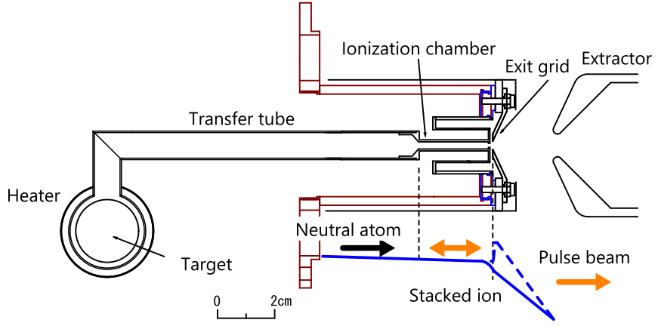
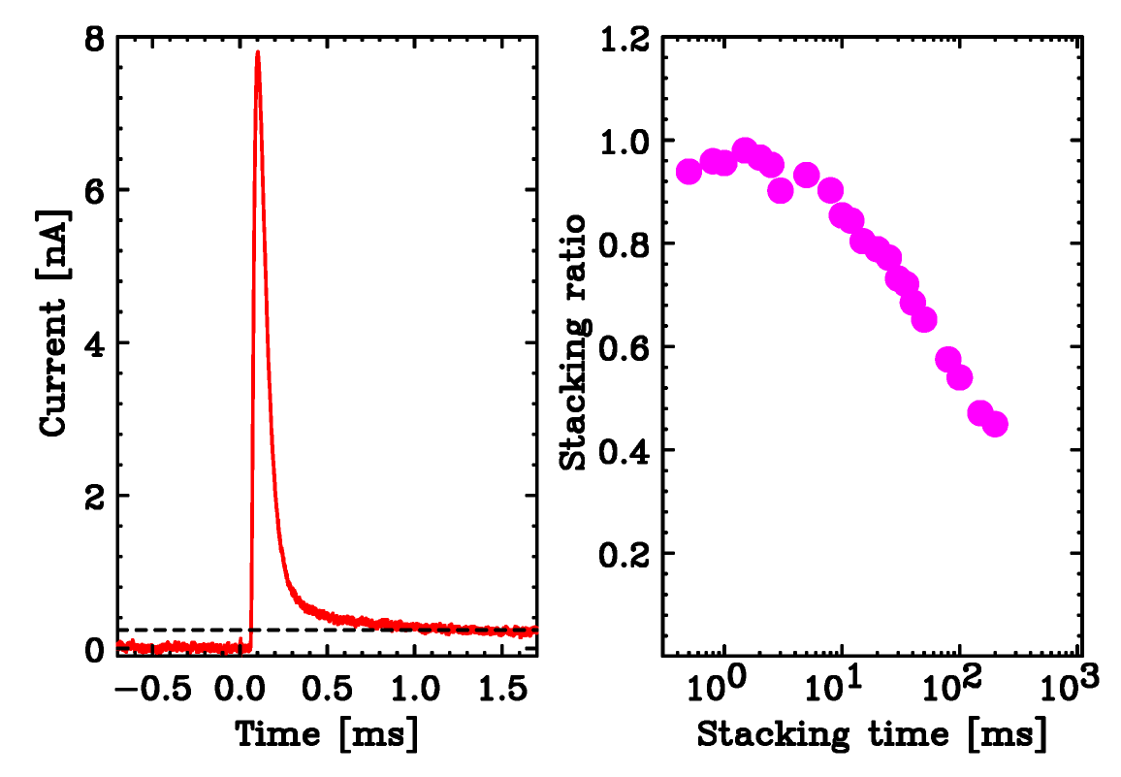
Ion source at ERIS
grid system
Forced electron beam induced arc discharge (FEBIAD)
Conversion to pulse beam
¹³²Xe)
1ms-stacking
DC
Surface ionization
¹³³Cs)
10ms-stacking
DC
Stacking ratio = Q(pulse)/Q(DC×Stacking time)
Notes:
At ERIS, there are two types of ion source, one is FEBIAD and the other one is surface ionization.
These figures show schematic drawings of each ion source.
These structure is almost same as the ISOLDE or other facilities.
One of the features is that both ion source have a grid system for pre-bunching and stacking.
These figures show the result of the pre-bunching with FEBAD and surface type.
With FEBIAD, the lifetime is almost a few ms
Due to high ionization efficiency, the lifetime is longer with the surface ionization type.

Slide 12
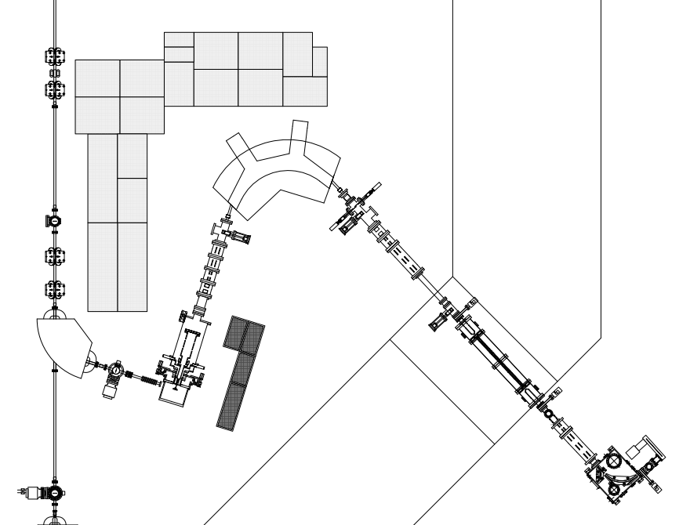
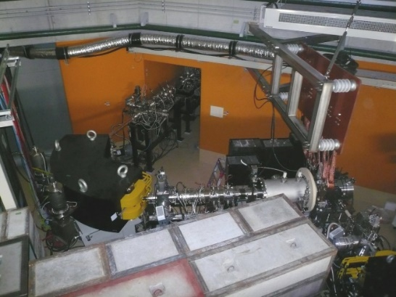
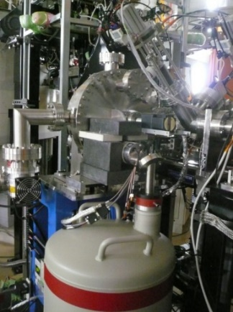
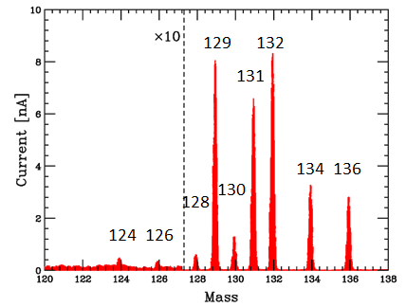
Transport line
Concreate block
Beam Diagnostic System (BDS)
FC+ CsI with CCD
Analyzing magnet
ERIS
Concreate wall
BDS
1mm
BDS
Steerer
Electric
Quadrupole
Electric
Quadrupole
¹²⁹Xe⁺
Steerer
BDS
e-beam
Pb block
Mass resolution M/ΔM: ~ 1660
FRAC
BDS
Target&
IonSource
BDS
PID system
Rotating target disk
Ge detector
Notes:
This figure shows the schematic layout of the transport line, and this photograph shows the transport line.
The transport line consists of an analyzing magnet and electric quadrupoles.
A beam diagnostic system consists of a faraday cup and CCD, and the profile and intensity of the ion beam are measured.
This figure shows the obtained mass spectrum with Xe beam, and the mass resolution reaches as 1600.
The PID system is installed at the exit of FRAC.
The rotating disk system and a Ge detector are used.

Slide 13
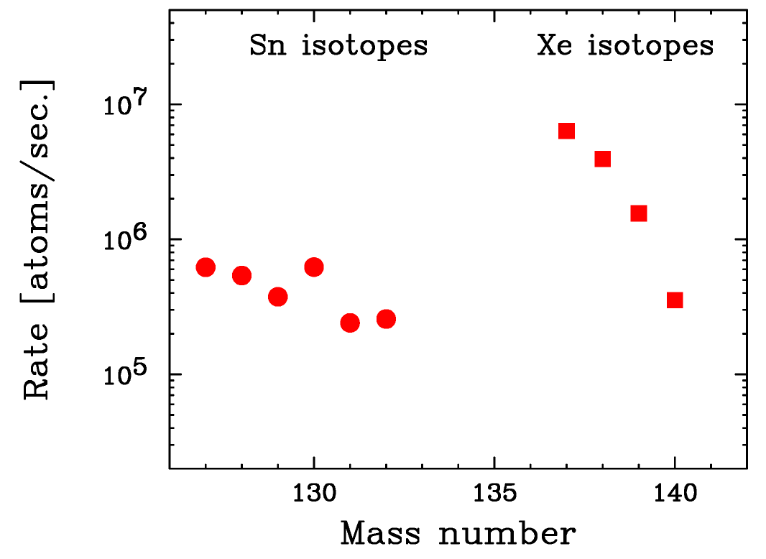
3. Results
RI production with FEBIAD
FEBIAD ion source
U 15g
10W electron beam
Overall efficiency = Release×Ionization×Transport
Exp./Calc.
Target～Ionization
from ¹²⁹Xe gas (14～15%)
 | Rate at 10W (atoms/s) | Calc at 10W (atoms/s) | Overall | Release
¹³⁸Xe | 3.9×10⁶ | 7.1×10⁷ | 5.5 % | 40 %
¹³²Sn | 2.6×10⁵ | 1.3×10⁷ | 2.0 % | 14 %
Notes:
Next, I would like to show you several results.
First result is the RI production with FEBIAD.
This figure shows the measured rate of Sn and Xe isotopes using FEBIAD ion source, 15 g uranium , and 10-W electron beam.
Here, overall efficiency is defined as release times ionization times and transport efficiencies.
Overall efficiency is deduced as a ratio of experimental rate to theoretical rate.
Release efficiency includes the diffusion efficiency inside the target and the effusion efficiency to ionization chamber.
This part was evaluated as 14-15% using stable 129Xe.
Using the obtained results of 138Xe and 132Sn, the overall efficiencies are deduced as 5.5 and 2% respectively. Release efficiencies are 40% and 14%, respectively.
(This overall efficiency is almost same as the results at the other facility.)
To improve the overall efficiency, more development is going on.

Slide 14
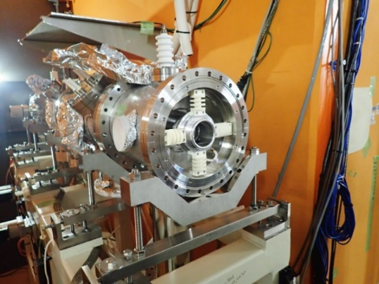
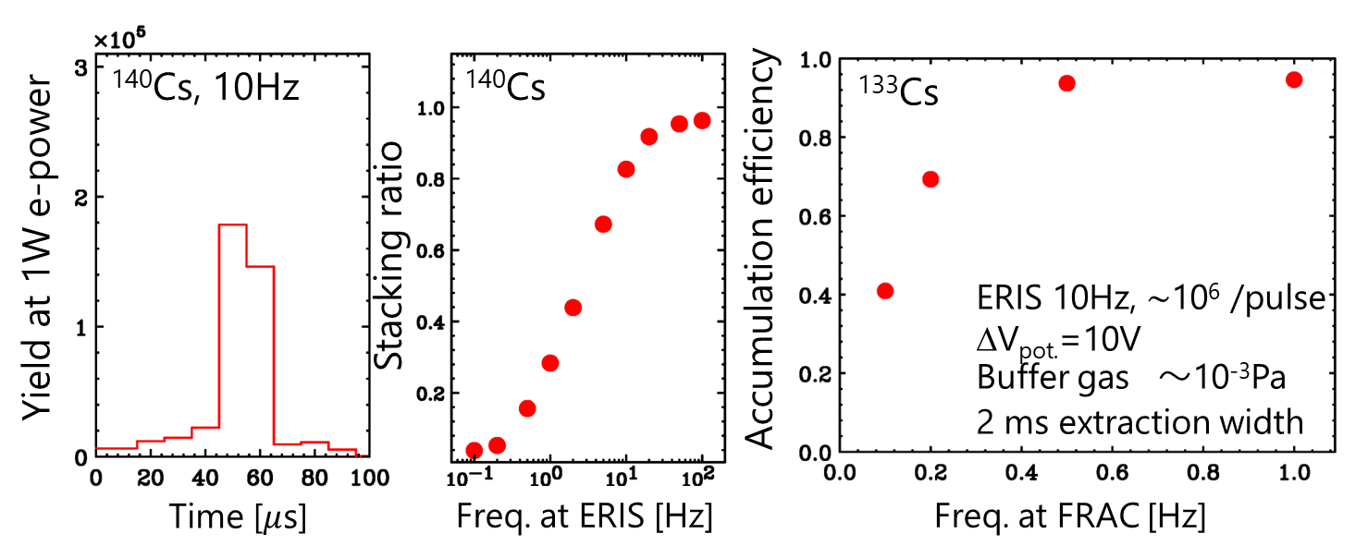
Two stage stacking inside ERIS & FRAC
Conversion from DC to pulse beam
Pulse beam from ERIS
Pulse beam
Stacking inside ERIS
FRAC Potential
ERIS stacking
FRAC stacking
Preliminary
Notes:
Two stage stacking inside ERIS and FRAC is developed to convert from continues beam to pulse beam.
After stacking inside ERIS, pulse beam from ERIS is injected to FRAC. After the accumulation inside FRAC, pulse beam is extracted and transported to SCRIT.
These figure shows the preliminary results of the stacking.
This figure shows the pulse shape of Cs beam,
and this figure shows the ratio of extracted ions to continuous beam depend on the operation frequency of ERIS. This figure shows the ratio of extracted ions to injected ions depend on the operating frequency of FRAC.
Each ratio reaches more than 90%, and this means that the total conversion efficiency reaches almost over 80%.

Slide 15
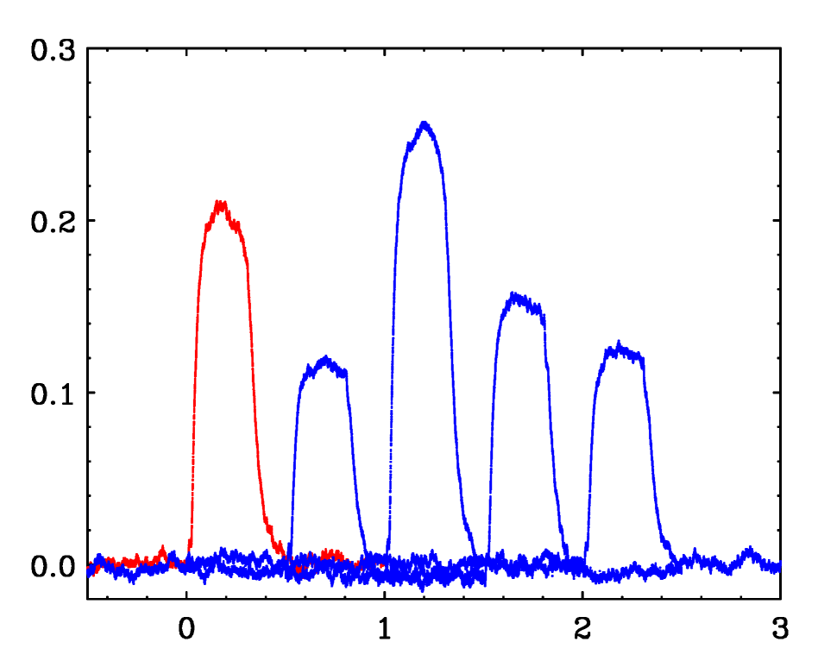
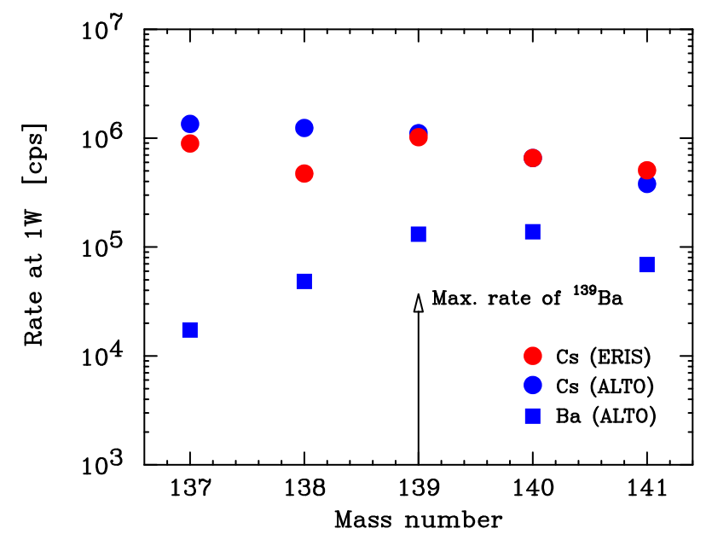
¹³⁷Cs beam production for e-RI scattering
ERIS 40 Hz, FRAC 1 Hz, RTM 15W, U 28g at FRAC exit
Short waiting time at ERIS
139
Time-shifted plots
137
Voltage [V]
140
138
141
ALTO: NIMB317(2013)218.
Normalized to ¹⁴⁰Cs at ERIS
Time [ms]
¹³⁷Ba/¹³⁷Cs < 0.5%
¹³⁷Cs pulse beam: 2×10⁷ ions/pulse to SCRIT(ERIS 40Hz, FRAC 0.25 Hz)
World's first electron scattering with online-produced RI
Notes:
Using two stage stacking, 137Cs beam was produced for e-RI elastic scattering.
This figure shows the time-shifted plots of the pulse shape of Cs isotopes with 40Hz ERIS and 1 Hz FRAC operation.
Right figure shows rates of Cs isotopes. Red and blue circles show rates of Cs isotopes at ERIS and ALTO facility, respectively. The results of ALTO facility is normalized to that of ERIS using the rate of 140Cs.
This discrepancy is considered that the accumulation time is not enough for 138Cs case.
Using the comparison between ERIS and ALTO results, the ratio of 137Ba to 137Cs is estimated to be less than 0.5%.
As a result, world's first electron scattering with online-produced RI was conducted using ERIS.

Slide 16
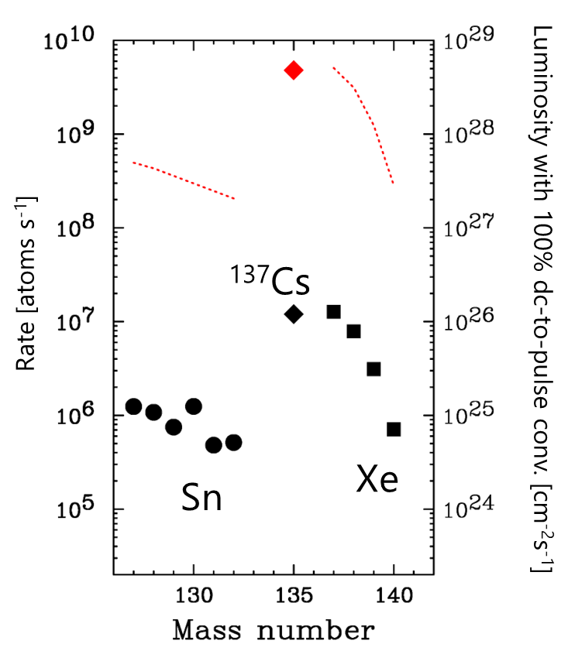
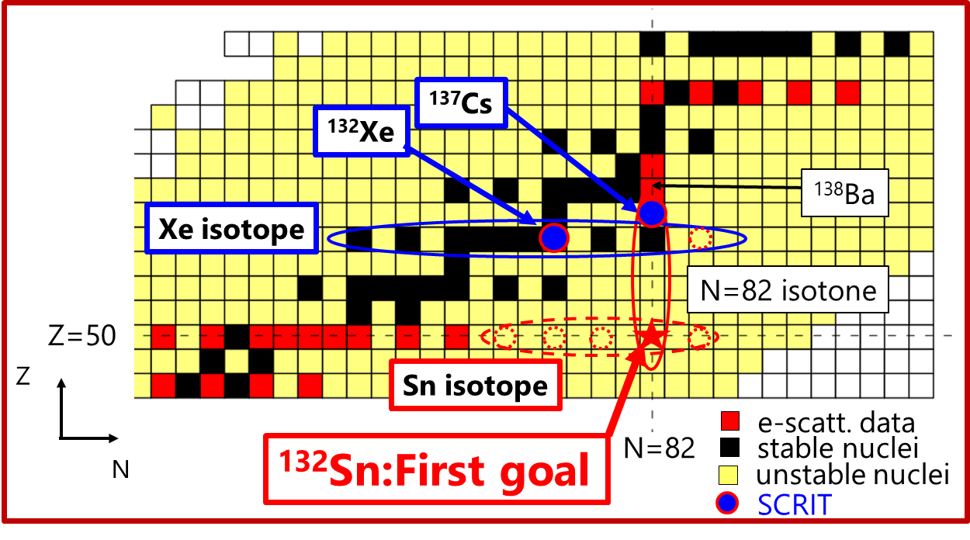
4. Future plan
1 kW beam
ERIS Eff. × 4
U 30g
"High intensity RI beam with high power electron beam"
10W beam
ERIS Eff. 5.5%(¹³⁸Xe)
2.0%(¹³²Sn)
5.5% (¹³⁷Cs)
Notes:
Next topic is future plan.
This is nuclear chart around Z=50.
Nuclei for which electron scattering data are available are indicated by red squares.
At the SCRIT facility, data for 132Xe and 137Cs were obtained.
132Sn is a symbolic nuclei due to the double magic number,
therefore, 132Sn is a first goal of the SCRIT project.
In addition, isotope dependence and isotone dependence are interesting subjects to study details of nuclear structure.
To perform these experiments, High intensity RI beam with high power, almost 1kW, electron beam is needed.
This figure shows rates of Sn and Xe isotopes at ERIS, and corresponding luminosity.
At the present power, 10W, rate of 132Sn is 10^6 ions/sec. After upgrading to 1kW beam, the rate of 132Sn reaches over 10^8 ions and luminosity becomes 10^27, and we can conduct electron scattering.

Slide 17
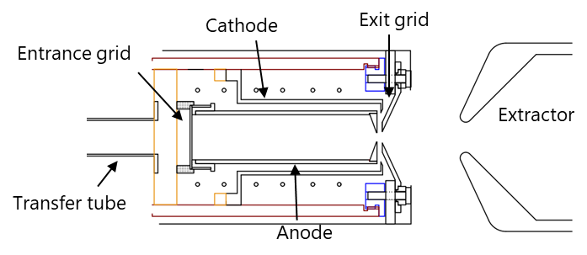
Towards the supply of high intensity RI beams
1. Upgrading of e-beam driver
Improvement items for 1～2 kW e-beam
Upgrading of RTM has been already started.
High frequency (～ 10 Hz ➔ ～ 100 Hz)
High peak current (～ 0.5 mA ➔ ～ 2.5 mA)
Long pulse width (～ 5 μs ➔ ～ 10 μs)
New klystron system
New injection line...
2. Upgrading of ERIS
EBGP type ion source
Improvement of overall efficiency
Uranium carbide target ➔ Nano material
More efficient structure of ion source
Improvement of RI separation
Isobar separation → Iimura-san's talk&Matsubara-san’s poster
3. High-power e-beam operation
Shielding
Maintenance scenario
Target operation
Notes:
Towards the supply of high intensity RI beams,
several subjects are considered.
First subject is upgrading of electron beam driver.
To achieve 1or 2kW e-beam, these improvements are needed.
high frequency, high peak current, and long pulse width of electron beam Upgrading of e-beam driver has been already started.
Second subject is upgrading of ERIS.
To improve the overall efficiency, uranium carbide target using nano material is considered, and
More efficient structure of ion source are planed, for example EBGP type ion source as shown here.
Concerning improvement of RI separation, especially isobar separation,
IImura-san's talk.
Third subject is high-power e-beam operation.
Shielding, maintenance scenario, and target operation are important tasks.
I would like show you more details of these tasks.

Slide 18
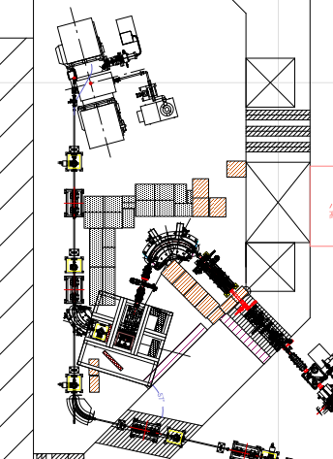
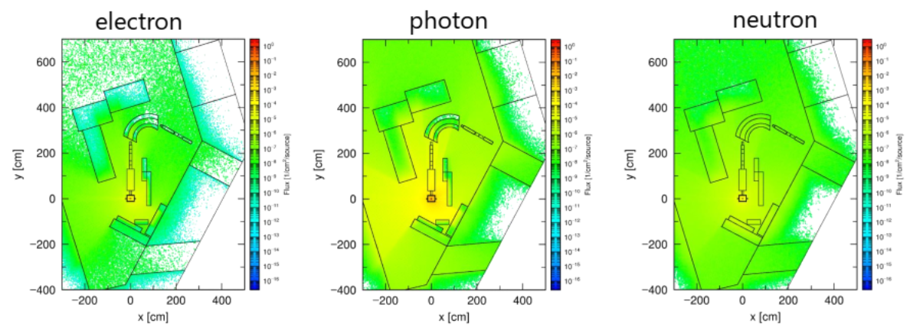
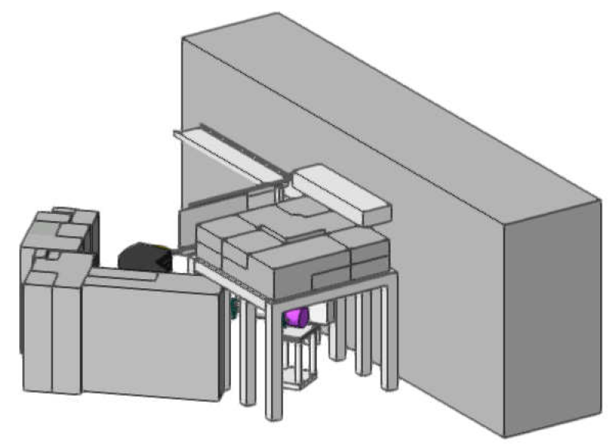
Shielding
Items for consideration in shielding
Radiation level for outside of controlled area
Prevent of radioactivation for electronics and devices
Additional shield
Phits calculation (±5mm from beam plane)
Evaluation of radiation level
Enhancement of shielding
Ceiling shield for ion source
Concreate: 2.4x2.4x0.6m³
Pb block: 0.8x0.8x0.1m³
Notes:
Concerning shielding, we must the consider radiation level for outside of controlled area, and prevent of radioactivation for electronics and devices.
To evaluate radiation level, phits calculation was performed.
From these results, the enhancement of shielding is considered.
This is the concept of the additional shielding around ion source.
and Red blocks are also additional concreate blocks.

Slide 19
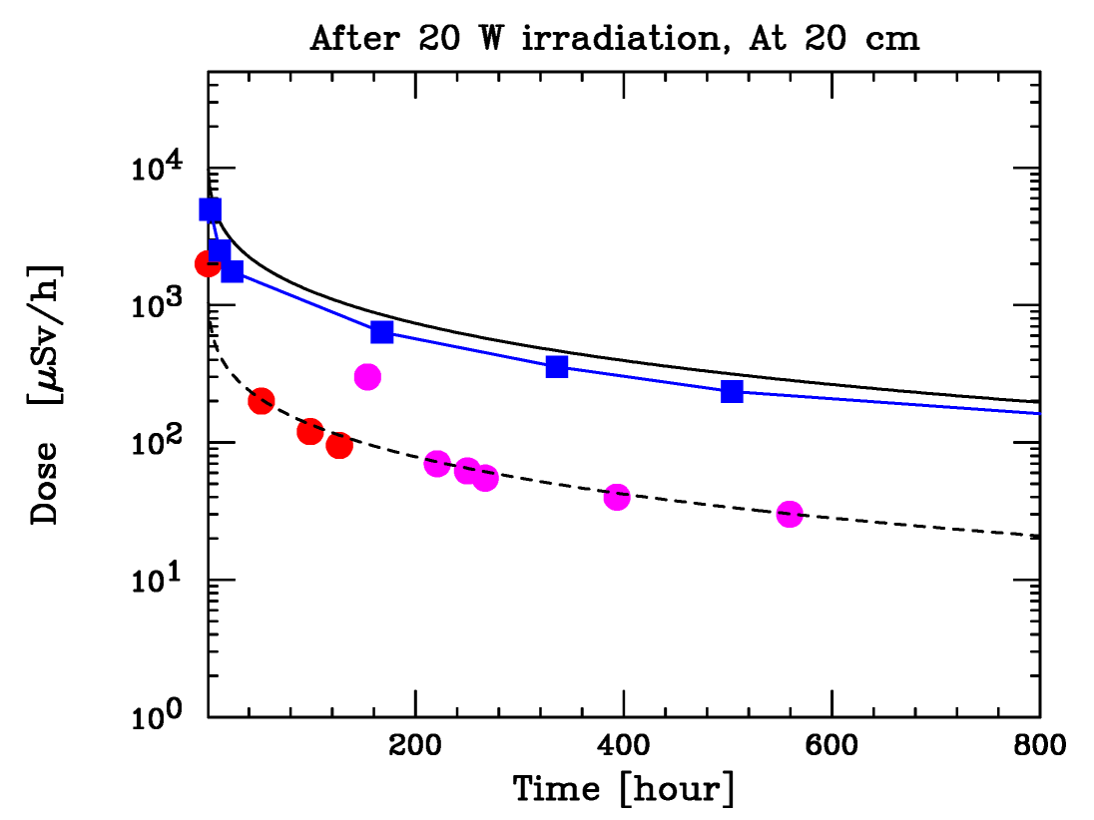
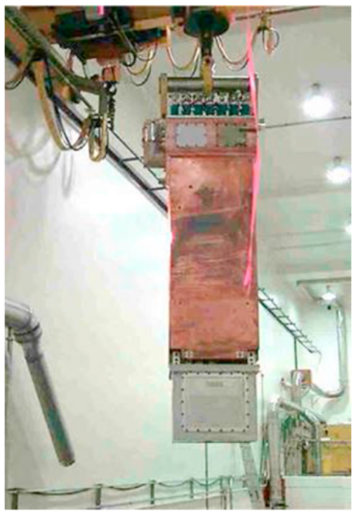
Maintenance scenario
Residual radiation from target
Measured data: 20 cm from target with 20W
～50 μSv/h after 2 weeks
2.5 mSv/h after 2 weeks @ 1kW
< 20 μSv/h after 2 years...
J.R.Lamarsh, Introduction to Nuclear Reactor Theory(1974)133.
×0.1
Phits+dchain-sp
Calculation → 10 times larger
Estimation of various locations
Exp. data
Waiting time for work: several weeks
➔ Remote handling system
Higher power(～100 kW) facility
Condition: 20 min. work, 2 mSv/h at 1m
ISAC target module at TRIUMF
Simpler system than other facilities
Crane system
Specialized working tools
Preparation of storage space
G. Minor et al.,
Nuclear Engineering and Technology 53 (2021) 1378
Notes:
In the maintenance scenario, residual radiation from target is big problem.
We measured the residual level at 20 cm from target.
This figure shows the time dependence of the results.
Red and magenta circles show the measured data.
Solid line show the empirical estimation.
Blue squares show results calculated with PHITS, and dchain-sp including the effect of target it self.
From this results, the residual radiation level was about 50 uSv/h after 2weeks of 20W irradiation.
In the case of 1kW irradiation, it becomes as 2.5 mSv/h after 2 weeks,
and it takes 2 years to become less than 20 uSv/h.
As a result, in our facility, waiting time for work is assumed as around several weeks.
Then, we consider remote handling system
with 20min working time at 2.5 mSV/h at a distance of 1m from the target.
This system is more simpler system than other facilities like this system.
Now, we are considering crane system, specialized working tools and preparation of storage space.

Slide 20
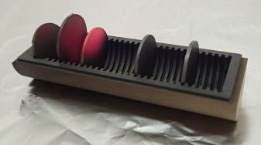
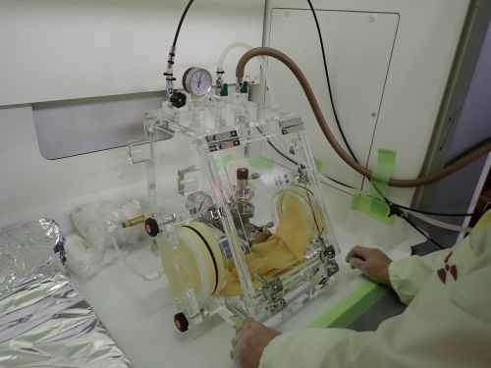
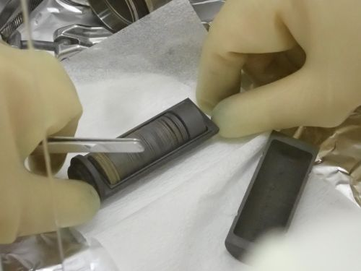
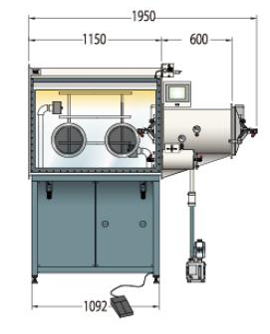
Target operation
Uranium carbide → Carbon nano material
Fast release, Long lifetime
A. Gottberg, NIMB 376 (2016) 8
Problem: Easily oxidization in the air
Uranium carbide with graphene
→ Oxidization began within a minute of being released in the air.
Present: Small glove box (only target) ➔ Large glove box (Ion source)
Notes:
Target operation is also important task.
Carbon nano material target is very good material due to fast release and long lifetime as reported in the previous work.
But, problem is easily oxidization in air.
This photograph shows the uranium carbide with graphene oxidized
within a minutes in the air.
In the present, we use small glove box for only target-related work as shown these photograph.
A large glove box is needed to do chamber-related work and handle safely nano material target.

Slide 21
Time schedule
2024
2025
2026
RTM Upgrade
Ion source maintenance
¹³²Sn experiment
Shielding & Remote handling
FRAC update
Gradually increasing beam power
Measurements are conducted and responded to on a case-by-case basis.
Notes:
This is rough time scale of upgrade plan.
We will start 132Sn experiment around 2026 or 2027.
Gradually increasing beam power, we will do measurement and respond to on a case-by-case basis.

Slide 22
Summary
・ERIS at the SCRIT electron scattering facility was constructed
and the development has been continued.
・The world’s first electron scattering with online-produced RI
was successfully conducted.
・The upgrade for high intensity RI beam has been already
started.
Electron scattering with ¹³²Sn will be performed soon.
For high power e-beam operation, global collaboration with other ISOL facilities is very important.
Notes:
Let me summarize my talk.
ERIS at the SCRIT electron scattering facility was constructed and the development has been continued.
The world's first electron scattering with online-produced RI was successfully conducted.
The upgrade for high intensity RI beam has been already started.
Then, electron scattering with 132Sn will be performed soon.
and for high power e-beam operation, global collaboration with other ISOL facilities is important.

Slide 23
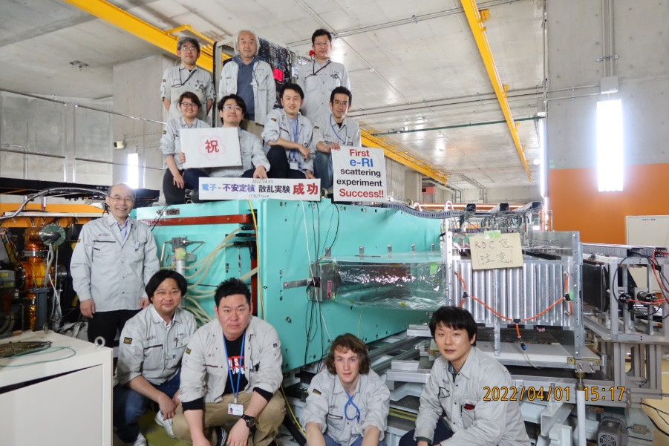
SCRIT collaboration
D. Abe¹, Y. Abe², R. Danjyo¹, A. Enokizono² , T. Goke¹, M. Hara² ,Y. Honda¹, T. Hori² , S. Iimura³, S. Ichikawa² , Y. Ishikura¹, K. Ishizaki¹, Y. Ito⁴, K. Kurita³, C. Legris¹, Y. Maeda⁴, Y. Maehara⁴, R. Obara¹, R. Ogawara² , T. Ohnishi²,
T. Suda^{1,2} , M. Tachibana⁴, T. Tamae¹, K. Tsukada^{2,4}, M. Wakasugi^{2,4},
M. Watanabe², H. Wauke^{1,2} , T. Yamano³, S. Yoshida⁴
¹ELPH Tohoku University, ²RIKEN, Nishina Center, ³Rikkyo University, ⁴ICR Kyoto University
Thank you for your attention!

Slide 24
Backups

Slide 25
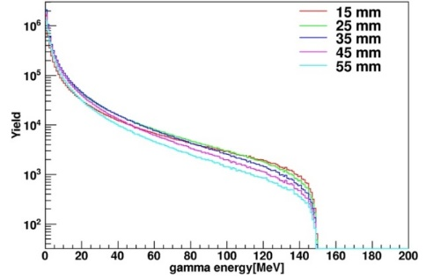
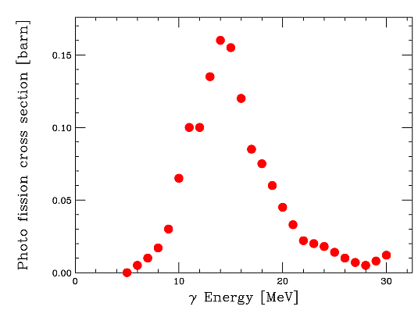
Electron beam-driven RI separator for SCRIT
RI production: Photo-fission of uranium(²³⁸U)
RI
RI
e⁻
γ
RI
150MeV
U target
Shower
²³⁸U
γ-ray production
Photo-fission
Separation
GEANT4
Measured cross section
ISOL
Mass separation
Chemical separation
×
＝
～10¹¹ fissions
(1kW , U 30g)
¹³²Sn ～10⁹ pps

Slide 26
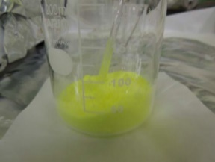
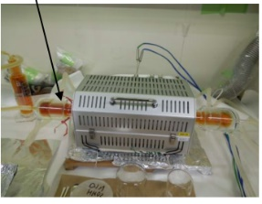
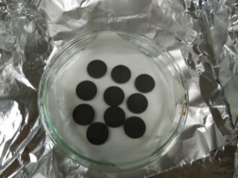
Target production
1) U₃O₈ powder → Uranyl nitrate solution
2) Impregnation with uranyl nitrate
to 20μm graphite grains
→ Oxidization under air flow around 500℃
UO₂(NO₃)₂・2H₂O → UO₃+NO+NO₂+O₂+2H₂O
3) Reground
4) Disk forming
5) Outgassing at 1000 ℃
NO_{x}
1)Uranyl nitrate
2)
3)
4)
Uranium-oxide-coated carbon disk
Φ20 mm, ～1 mm thickness, U 0.7g, C 0.35 g, C/U～10

Slide 27
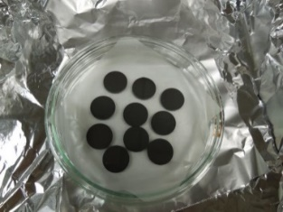
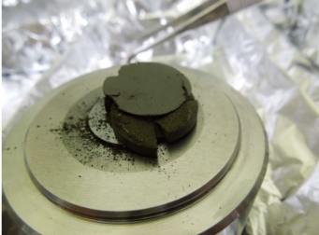
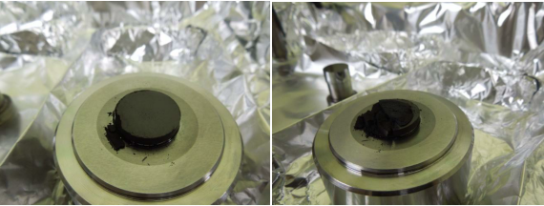
4) Disk forming
Condition : 180 MPa compression with no binder
Success: Uranyl nitrate solution mixed with graphite powder
Failure: UO₃ or U₃O₈ powder mixed with graphite powder
UO₃
U₃O₈
Guess: NO_{x} bubbles make a poromeric uranium oxide.
→ Still under investigation

Slide 28
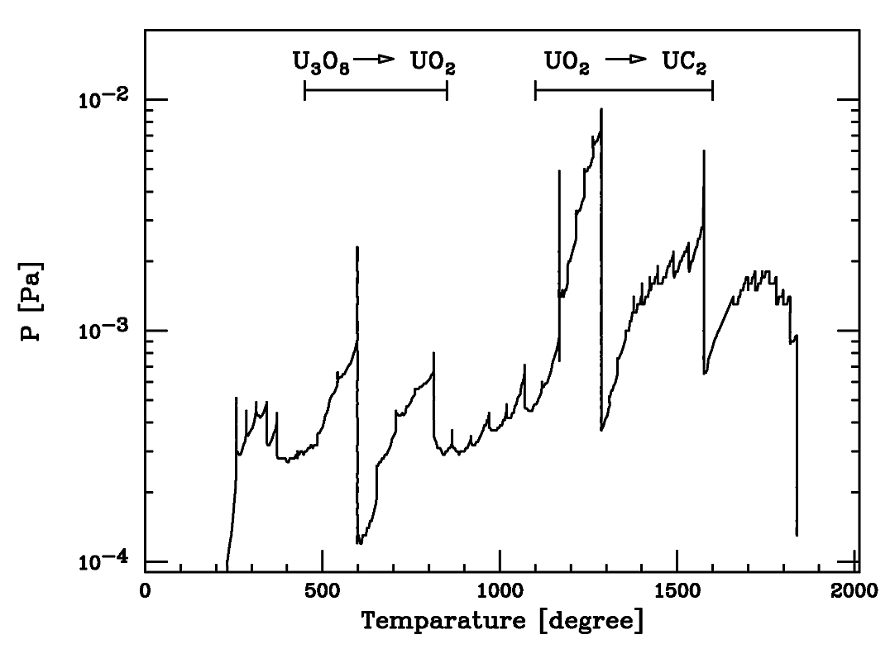
6) Cartbothermal reduction
Uranium-oxide-coated disk → Uranium carbide disk
U₃O₈ +C ➔ 3UO₂+CO₂ at 600-800℃
UO₂ + 4C ➔ UC₂ + 2CO at 1100-1600℃
Ref. Gmelin handbook Supp. Vol. C12
UO₂ 9 g (U 8 g) + C 2.2 g
2 h
2 h
12 h

Slide 29
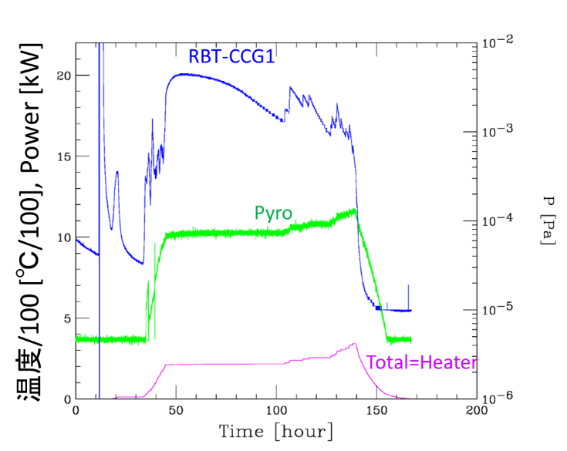
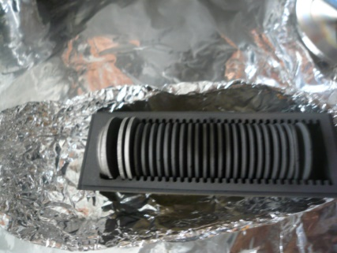
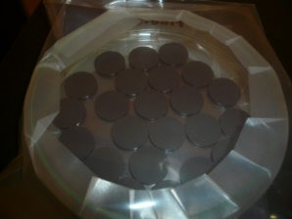
U 15g : 94.5 hours
Before
After
Φ 20 mm → 18 mm
t 1mm → 0.8 mm
23 disks, Total U 15 g
1 disk: U density : ～ 3.4 g/cm³
U 0.7g, C 0.35 g
Offline carbothermal-reduction device
Heater & Cooling water
Control system: NI USB-6001&net USB

Slide 30
FRAC (Fringing RF field activated ion beam compressor)
M. Wakasugi et al., Rev. Sci. Instrum. 89 (2018) 095107.
FRAC converts 1-s DC beam into 500 μs pulse beam
Based on RFQ linear trap
RFQ electrodes
Length
Bore
Freq.
V_{RF}
950 mm
16 mmφ
0.3~3 MHz
< 500 V
Barrier electrodes
Injection electrode
Einzel lens

Slide 31
Cooling process in FRAC
Low-pressure buffer gas (～10⁻³ Pa)
・ Accumulation of large number of ions (～10⁸ ions at 0.5 -1Hz) ・ Fast extraction with in 500 μs
・ Large RF amplitude
・ SCRIT is operated under high vacuum of 10⁻⁸ Pa.
➔ Long cooling time in FRAC > 50 ms
Buffer: 2$×$10⁻³ Pa
Average energy [eV]
Cooling time [ms]

Slide 32
Isobar selection
・化学分離
R. Kirchner, NIMB204(2003)179.
硫化物の利用
SnSでの供給
・高分解能質量分離
MR-TOF などを利用した分離

